Slide 1

Advanced Programming CMP 102
Dr. Perihan PEHLİVANOĞLU
Biruni Univarsity
Department of Computer Engineering 2023
Spring

Slide 2
Course Plan
Introduction - Functions (Recursive functions) Arrays, ArrayList, Vector
Collections (List, Queue, Stack, Set, Map, Tree)
Streams, Files
Generics and Exceptions
Midterm Exam

Slide 3
Course Plan
Visual Programming Fundamentals Designing a Form Controls and Forms Properties of Components and Events Final Exam

Slide 4

Last Lecture
JavaFX examples.

Slide 5
Motivation
In this lecture, we will focus on example programs in visual programming in Java. We will use Scene Builder.

Slide 6
JavaFX Program Structure

Slide 7
A JavaFX Program
It consists of Stage, Scene and nodes.

Slide 8
The Basic Structure of a JavaFX Program
JavaFX is a modern graphical user interface (GUI) framework for creating desktop and mobile applications. The program structure of a JavaFX application consists of the following components:
Application class: This is the entry point of the JavaFX application, which extends the javafx.application.Application class. It contains the main() method, which launches the application.
Stage class: A stage represents a top-level container or window of a JavaFX application. The stage is created in the start() method of the Application class.
Scene class: A scene represents the content of a stage, which is defined using the javafx.scene.Scene class. A scene can contain one or more nodes, such as buttons, text fields, labels, and images.
Layouts: JavaFX provides various layout classes to arrange nodes in the scene, such as VBox, HBox, BorderPane, GridPane, and FlowPane. These layouts help to organize the user interface elements in a structured manner.
Nodes: Nodes are the graphical components that are placed inside the scene, such as buttons, text fields, labels, and images. Each node is an instance of a class that extends the javafx.scene.Node class.
Event handling: JavaFX provides a comprehensive event handling mechanism to handle user interactions, such as button clicks, mouse movements, and key presses. Event handling is done using the EventHandler interface and the setOn<ActionEvent>() method.
CSS styling: JavaFX supports CSS styling for styling the user interface elements. You can use CSS to define the color, font, size, and layout of the nodes in the scene.
In summary, the program structure of a JavaFX application consists of the Application class, Stage class, Scene class, Layouts, Nodes, Event handling, and CSS styling.

Slide 9
The Basic Structure of a JavaFX Program
A Stage object is a window. A Stage object called primary stage is automatically created by the JVM when the application is launched.
JavaFX names the Stage and Scene classes using the analogy from the theater. You may think of stage as the platform to support scenes, and nodes as actors to perform in the scenes.
You can create additional stages if needed.

Slide 10
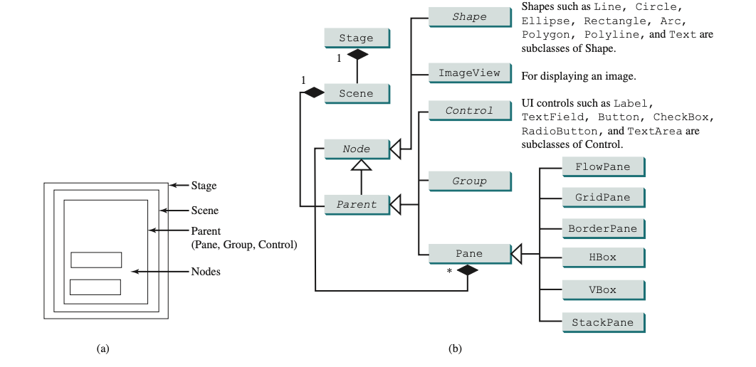
Pane, Group, UI Control, Shape
Their relationships with each other.

Slide 11
The Basic Structure of a JavaFX Program
A shape refers to a text, line, circle, ellipse, rectangle, arc, polygon, polyline, and so on.
A UI control refers to a label, button, check box, radio button, text field, text area, and so on.
A group is a container that groups a collection of nodes. You can apply transformations or effects to a group, which automatically apply to all the children in the group.
A scene can be displayed in a stage. Note a Scene can contain a Control, Group, or a Pane, but not a Shape or an ImageView.
A Pane or a Group can contain any subtype of Node. You can create a Scene using the constructor Scene(Parent, width, height) or Scene(Parent).

Slide 12
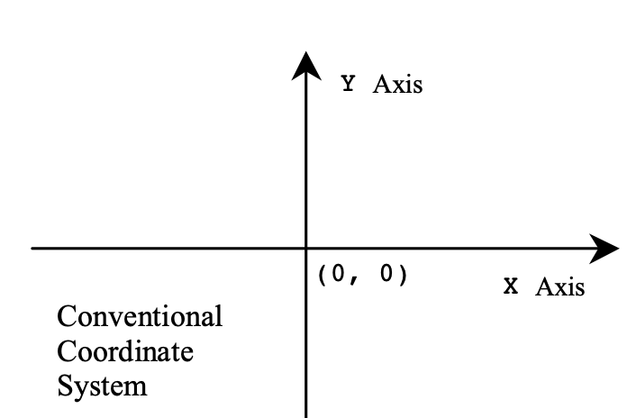
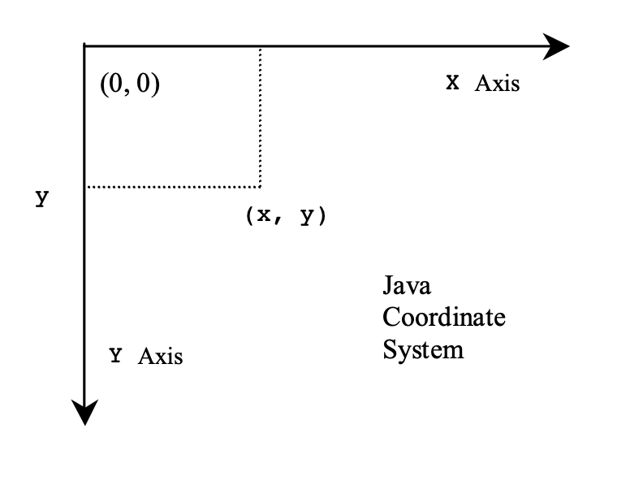
Show a shape on the screen
Coordinate system in Java

Slide 13
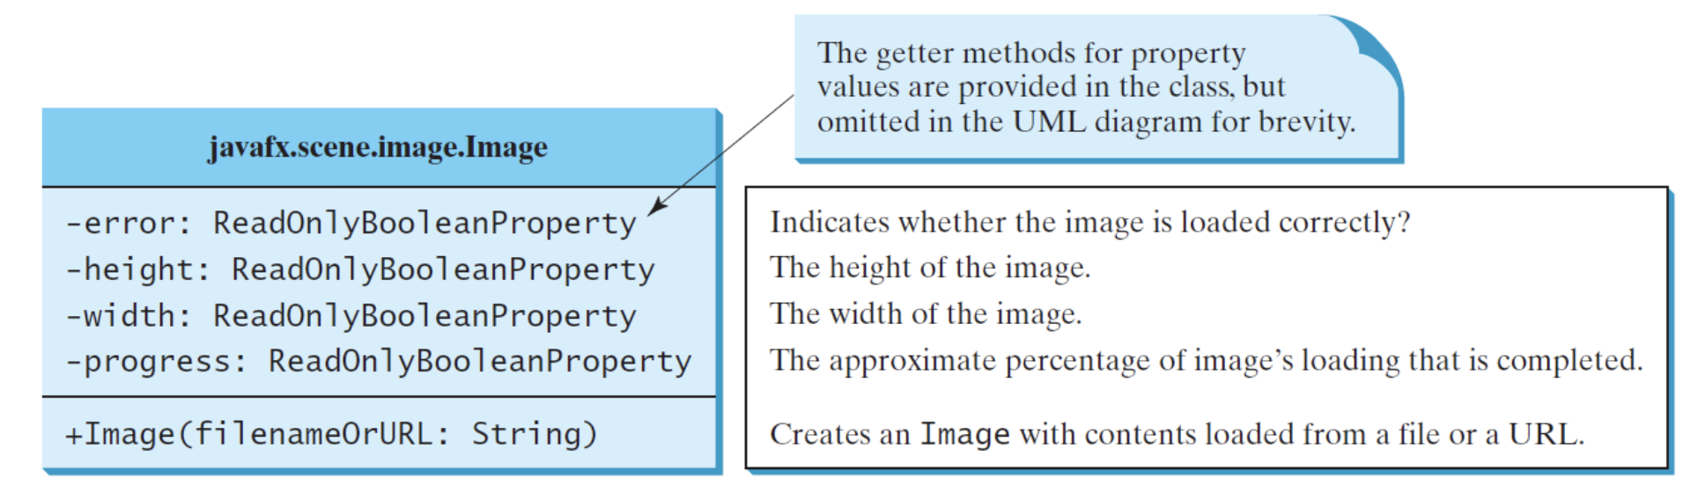
Image Class
Let's examine the image properties and methods.

Slide 14
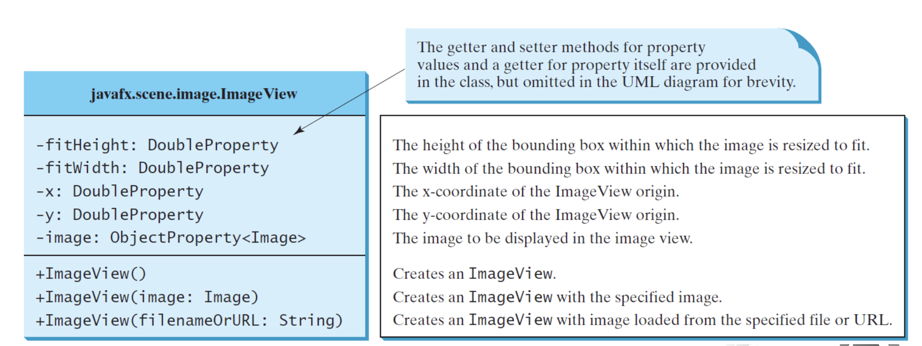
ImageView Class
Let's examine ImageView properties and methods.

Slide 15
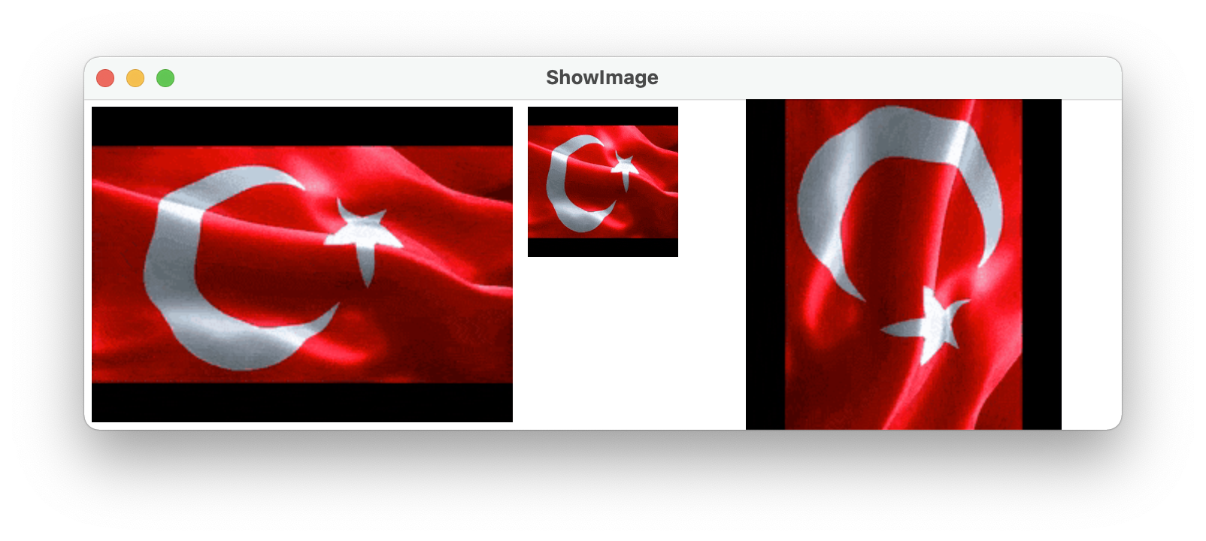
ImageView
package com.example.deneme5;
import javafx.application.Application;
import javafx.geometry.Insets;
import javafx.scene.Scene;
import javafx.scene.image.Image;
import javafx.scene.image.ImageView;
import javafx.scene.layout.HBox;
import javafx.scene.layout.Pane;
import javafx.stage.Stage;
import java.io.IOException;
public class HelloApplication extends Application {
@Override
public void start(Stage primaryStage) throws IOException {
// Create a pane to hold the image views
Pane pane = new HBox(10);
pane.setPadding(new Insets(5, 5, 5, 5));
Image image = new Image("turk.gif");
pane.getChildren().add(new ImageView(image));
ImageView imageView2 = new ImageView(image);
imageView2.setFitHeight(100);
imageView2.setFitWidth(100);
pane.getChildren().add(imageView2);
ImageView imageView3 = new ImageView(image);
imageView3.setRotate(90);
pane.getChildren().add(imageView3);
// Create a scene and place it in the stage
Scene scene = new Scene(pane);
primaryStage.setTitle("ShowImage"); // Set the stage title
primaryStage.setScene(scene); // Place the scene in the stage
primaryStage.show(); // Display the stage
}
public static void main(String[] args) {
launch(args);
}
}
ShowImage

Slide 16
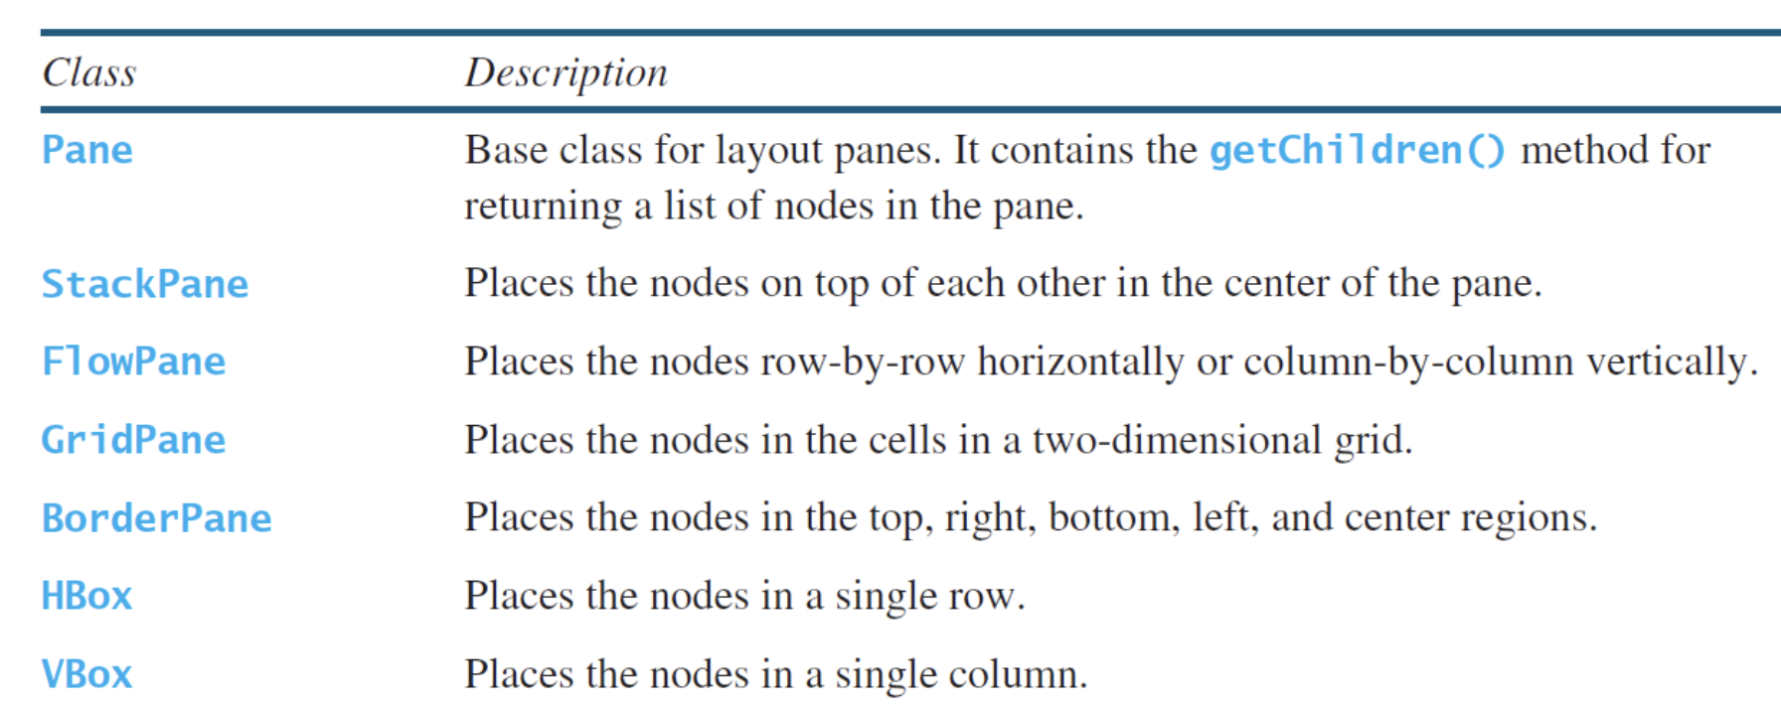
Panes
Panes and groups are the containers for holding nodes. The Group class is often used to group nodes and to perform transformation and scale as a group. Panes and UI control objects are resizable, but group, shape, and text objects are not resizable. JavaFX provides many types of panes for organizing nodes in a container

Slide 17
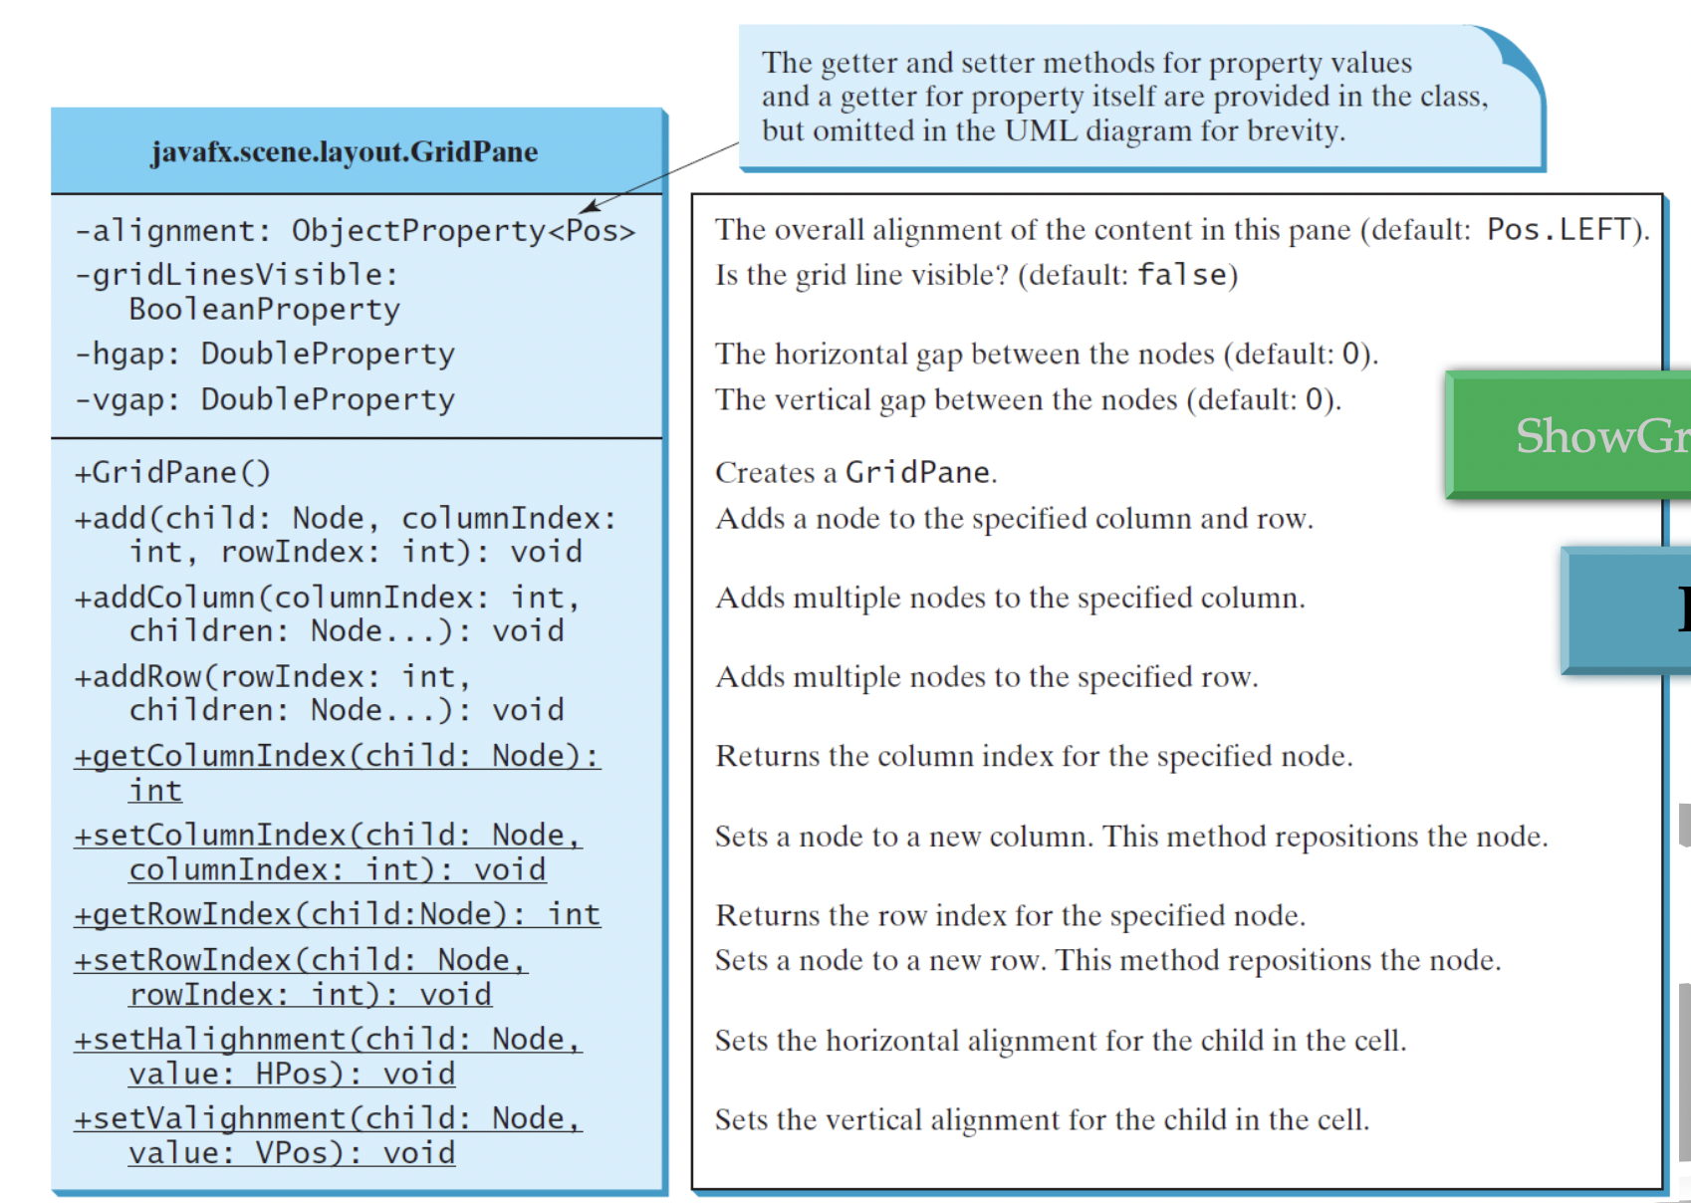
GridPane Class
Let's examine the GridPane properties and methods.

Slide 18
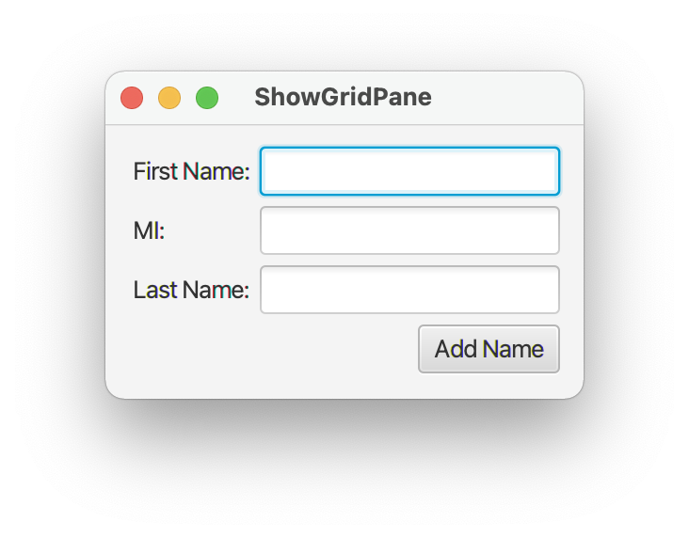
GridPane
package com.example.deneme5;
import javafx.application.Application;
import javafx.geometry.HPos;
import javafx.geometry.Insets;
import javafx.geometry.Pos;
import javafx.scene.Scene;
import javafx.scene.control.Button;
import javafx.scene.control.Label;
import javafx.scene.control.TextField;
import javafx.scene.layout.GridPane;
import javafx.stage.Stage;
import java.io.IOException;
public class HelloApplication extends Application {
@Override
public void start(Stage primaryStage) throws IOException {
// Create a pane and set its properties
GridPane pane = new GridPane();
pane.setAlignment(Pos.CENTER); // Set center alignment
pane.setPadding(new Insets(11.5, 12.5, 13.5, 14.5));
pane.setHgap(5.5);
pane.setVgap(5.5); // Set vGap to 5.5px
// Place nodes in the pane
pane.add(new Label("First Name:"), 0, 0);
pane.add(new TextField(), 1, 0);
pane.add(new Label("MI:"), 0, 1);
pane.add(new TextField(), 1, 1);
pane.add(new Label("Last Name:"), 0, 2);
pane.add(new TextField(), 1, 2);
Button btAdd = new Button("Add Name");
pane.add(btAdd, 1, 3);
GridPane.setHalignment(btAdd, HPos.RIGHT);
// Create a scene and place it in the stage
Scene scene = new Scene(pane);
primaryStage.setTitle("ShowGridPane"); // Set the stage title
primaryStage.setScene(scene); // Place the scene in the stage
primaryStage.show(); // Display the stage
}
public static void main(String[] args) {
launch(args);
}
}
ShowGridPane

Slide 19
Shapes Class
The Shape class is the abstract base class that defines the common properties for all shapes. Among them are the fill, stroke, and strokeWidth properties.
The fill property specifies a color that fills the interior of a shape.
The stroke property specifies a color that is used to draw the outline of a shape.
The strokeWidth property specifies the width of the outline of a shape.

Slide 20
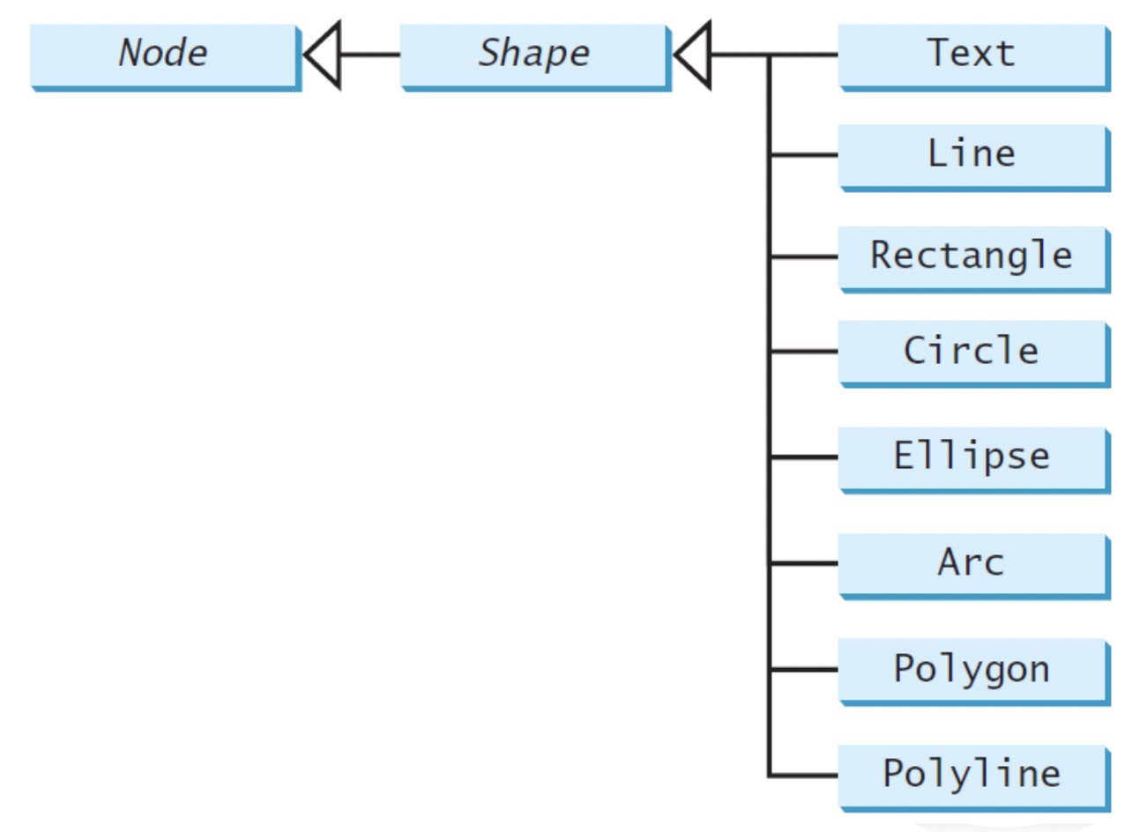
Shapes Class
This section introduces the classes Text, Line, Rectangle, Circle, Ellipse, Arc, Polygon, and Polyline for drawing texts and simple shapes. All these are subclasses of Shape.

Slide 21
JavaFX Scene Builder

Slide 22
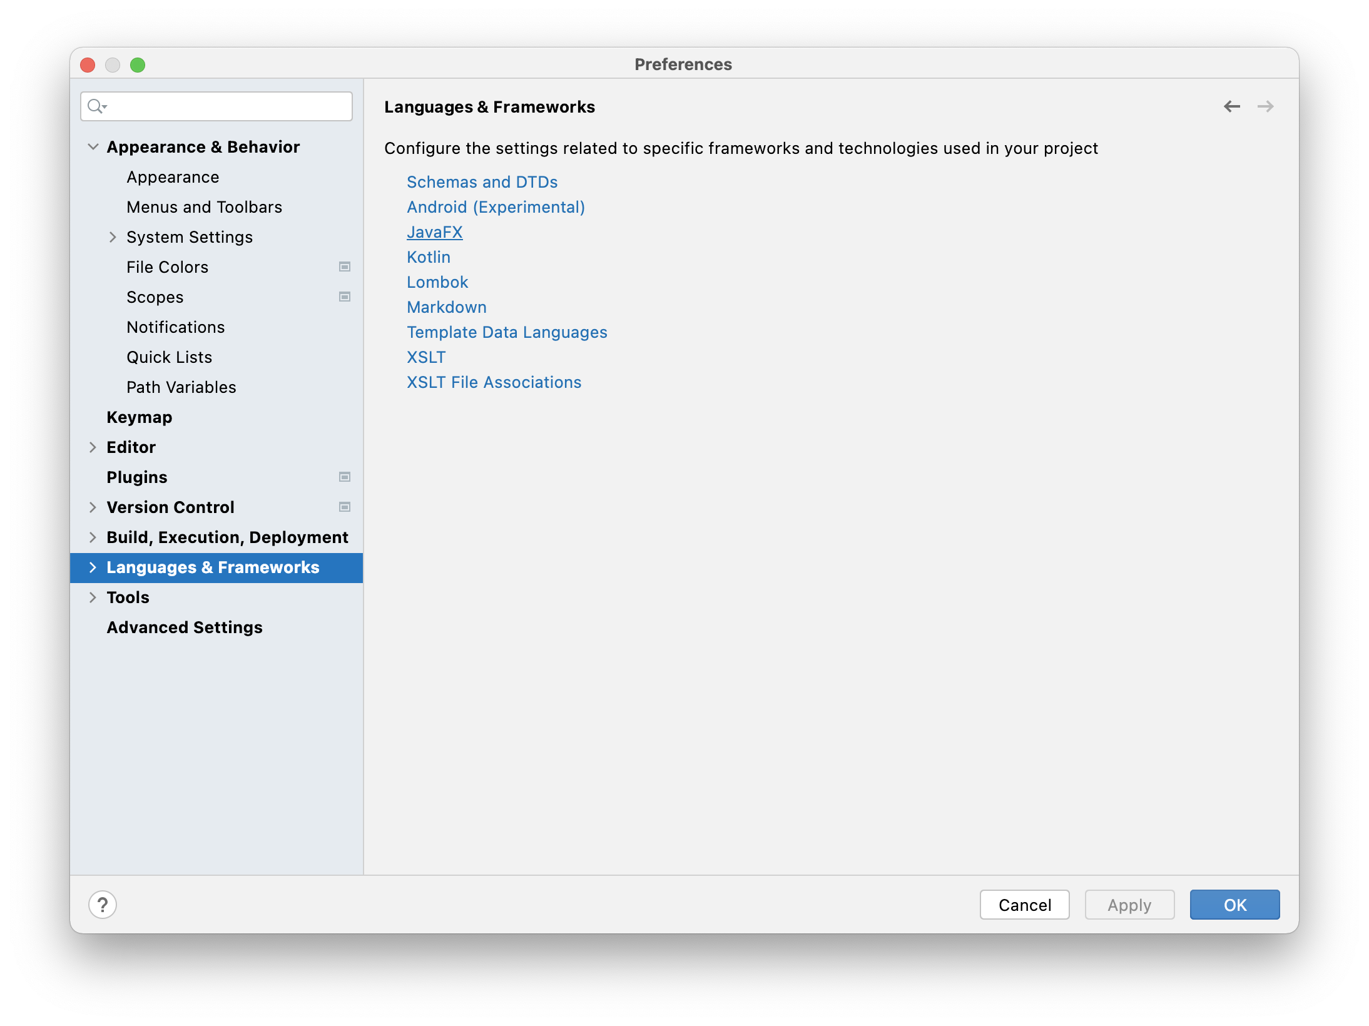
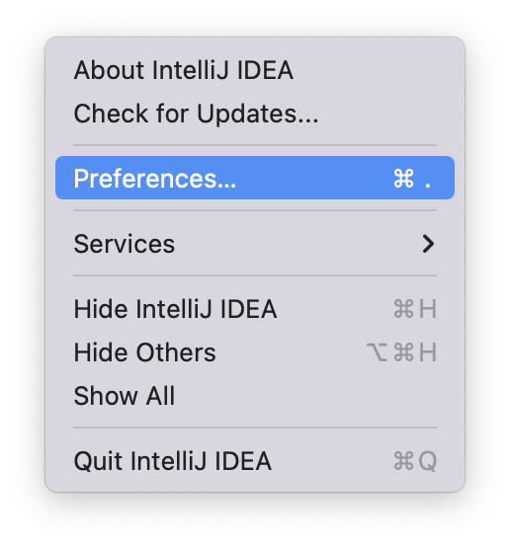
JavaFX Scene Builder Setup IntelliJ IDEA
Setup JavaFX Scene Builder.

Slide 23
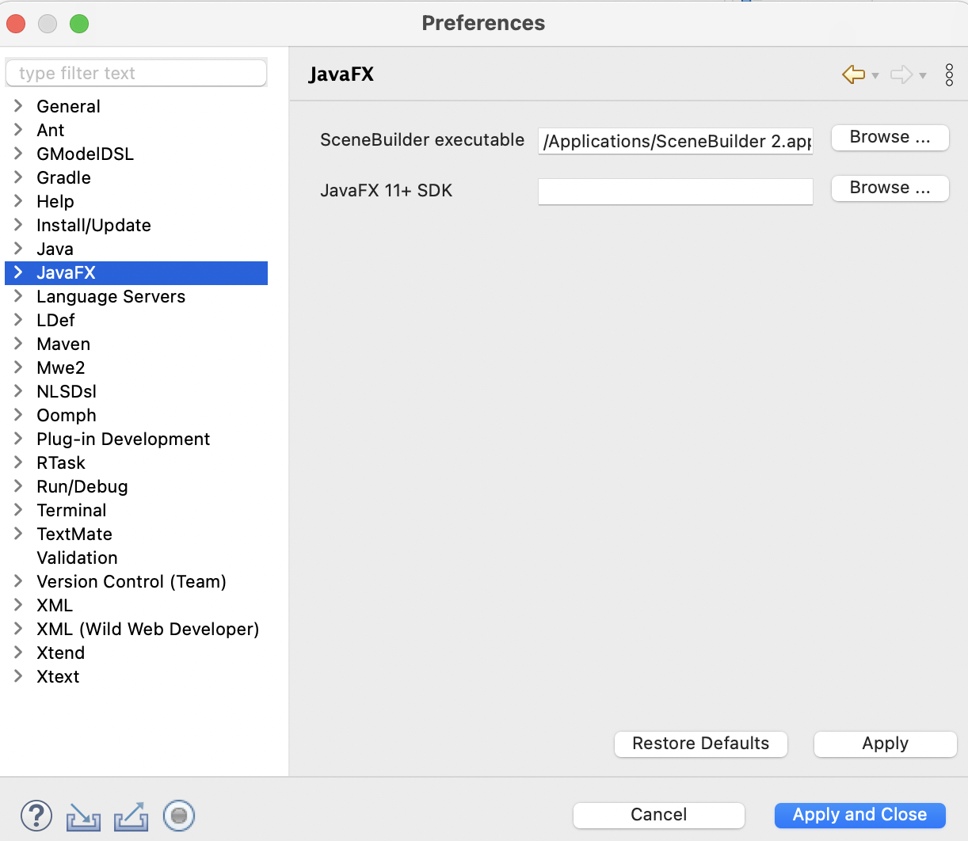
JavaFX Scene Builder Setup Eclipse
Setup JavaFX Scene Builder.

Slide 24
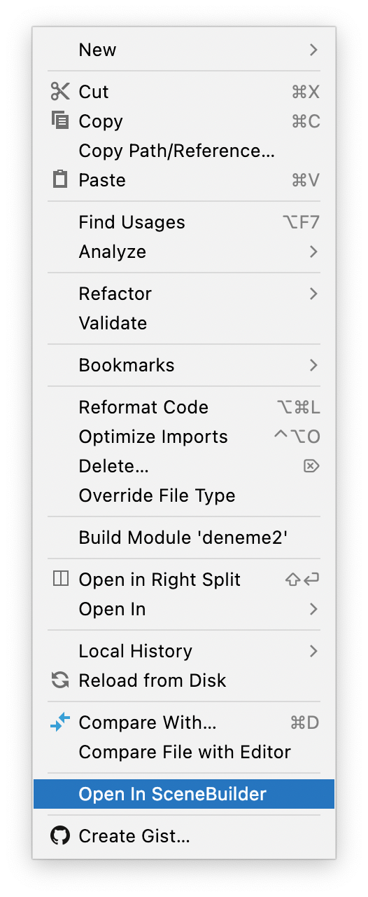
Open JavaFX Scene Builder
Open JavaFX Scene Builder.

Slide 25
Java FX UI Controls
You can add controls to a form that you create with Java FX User User Interface Controls.
Label
Button
Radio Button
Toggle Button
Checkbox
Choice Box
Text Field
Password Field
Scroll Bar
Scroll Pane
List View
Table View
Tree View
Tree Table View
Combo Box
Separator
Slider
Progress Bar and Progress Indicator
Hyperlink
Tooltip
HTML Editor
Titled Pane and Accordion
Menu
Color Picker
Date Picker
Pagination Control
File Chooser
Customization of UI Controls
UI Controls on the Embedded Platforms

Slide 26
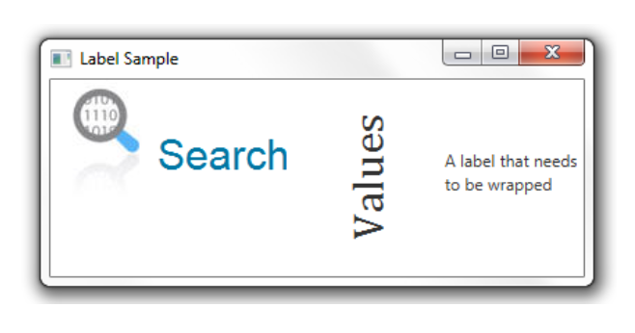
Label
The Label is in the javafx.scene.control library and is used to add the text element to forms. The image shows 3 uses of the label control. The setText() method is used to add text to the label.
//An empty label
Label label1 = new Label();
//A label with the text element
Label label2 = new Label("Search");
//A label with the text element and graphical icon
Image image = new Image(getClass().getResourceAsStream("labels.jpg")); Label label3 = new Label("Search", new ImageView(image));
Label label1 = new Label("Search");
Image image = new Image(getClass().getResourceAsStream("labels.jpg"));
label1.setGraphic(new ImageView(image));
label1.setTextFill(Color.web("#0076a3"));

Slide 27
Label
You can change the font of the Label.
//Use a constructor of the Font class
Label label1, label2;
label1.setFont(new Font("Arial", 30));
//Use the font method of the Font class
label2.setFont(Font.font("Cambria", 32));
Label label3 = new Label("A label that needs to be wrapped");
label3.setWrapText(true);

Slide 28
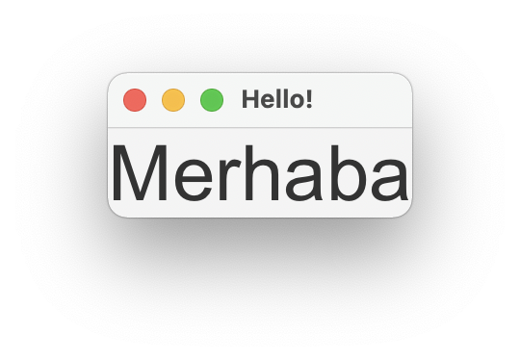
Visual Program Example - 1
Let's prepare a visual program using Label.

Slide 29
Label Program
package com.example.kontrollerprj1;
import javafx.application.Application;
import javafx.fxml.FXMLLoader;
import javafx.scene.Scene;
import javafx.scene.control.Label;
import javafx.scene.layout.AnchorPane;
import javafx.scene.text.Font;
import javafx.stage.Stage;
import java.io.IOException;
public class HelloApplication extends Application {
@Override
public void start(Stage stage) throws IOException {
AnchorPane root = new AnchorPane();
Scene scene = new Scene(root);
Label etiket = new Label ("Merhaba");
etiket.setFont(Font.font("Arial",40));
root.getChildren().add(etiket);
stage.setTitle(“Hello!");
stage.setScene(scene);
stage.show();
}
public static void main(String[] args) {
launch();
}
}

Slide 30
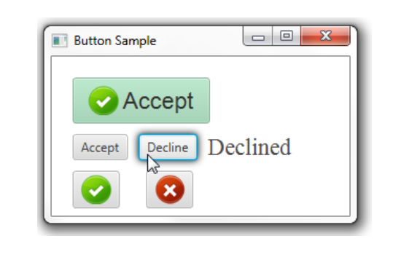
Button
Button is used to add the button element to forms. The image shows how to use the button control. You can add a caption to the button with setText().
//A button with an empty text caption.
Button button1 = new Button();
//A button with the specified text caption.
Button button2 = new Button("Kabul");
//A button with the specified text caption and icon.
Image imageOk = new Image(getClass().getResourceAsStream(“ok.png"));
Button button3 = new Button("Accept", new ImageView(imageOk));

Slide 31
Button
When you click the button, you can add actions as follows.
button2.setOnAction((ActionEvent e)
{ label.setText("Accepted");
}

Slide 32
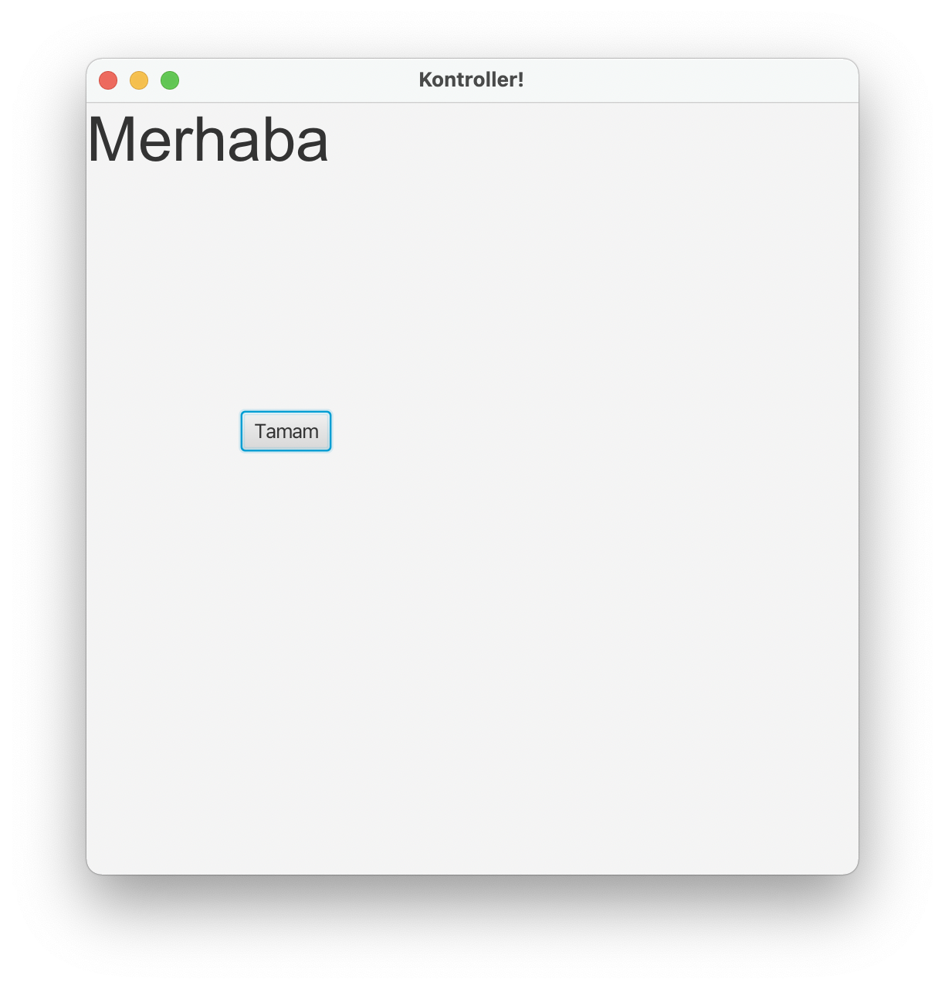
Visual Program Example - 2
Let's prepare a visual program using Label and Button.

Slide 33
Button Program
package com.example.kontrollerprj1;
import javafx.application.Application;
import javafx.fxml.FXMLLoader;
import javafx.scene.Scene;
import javafx.scene.control.Button;
import javafx.scene.control.Label;
import javafx.scene.image.Image;
import javafx.scene.image.ImageView;
import javafx.scene.layout.AnchorPane;
import javafx.scene.text.Font;
import javafx.stage.Stage;
import java.io.IOException;
public class HelloApplication extends Application {
@Override
public void start(Stage stage) throws IOException {
AnchorPane root = new AnchorPane();
Scene scene = new Scene(root, 500,500);
Label etiket = new Label ("Merhaba");
etiket.setFont(Font.font("Arial",40));
root.getChildren().add(etiket);
Button dugme = new Button("Tamam");
dugme.setLayoutX(100);
dugme.setLayoutY(200);
root.getChildren().add(dugme);
stage.setTitle("Kontroller!");
stage.setScene(scene);
stage.show();
}
public static void main(String[] args) {
launch();
}
}

Slide 34
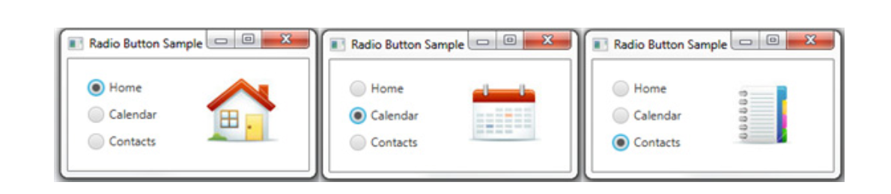
Radio Button
The Radio Button control is used for selection. By grouping, only one of them can be selected within the group.
To select a radio button you can set setSelected() method. The isSelected() method is used to check whether it is selected.
//A radio button with an empty string for its label
RadioButton rb1 = new RadioButton();
//Setting a text label
rb1.setText("Home");
//A radio button with the specified label
RadioButton rb2 = new RadioButton("Calendar");
Image image = new Image(getClass().getResourceAsStream(“/ok.jpg"));
rb2.setGraphic(new ImageView(image));

Slide 35
Radio Button
In the Radio Buttons group, it is necessary to group only 1 radio button to ensure that it is selected.

Slide 36
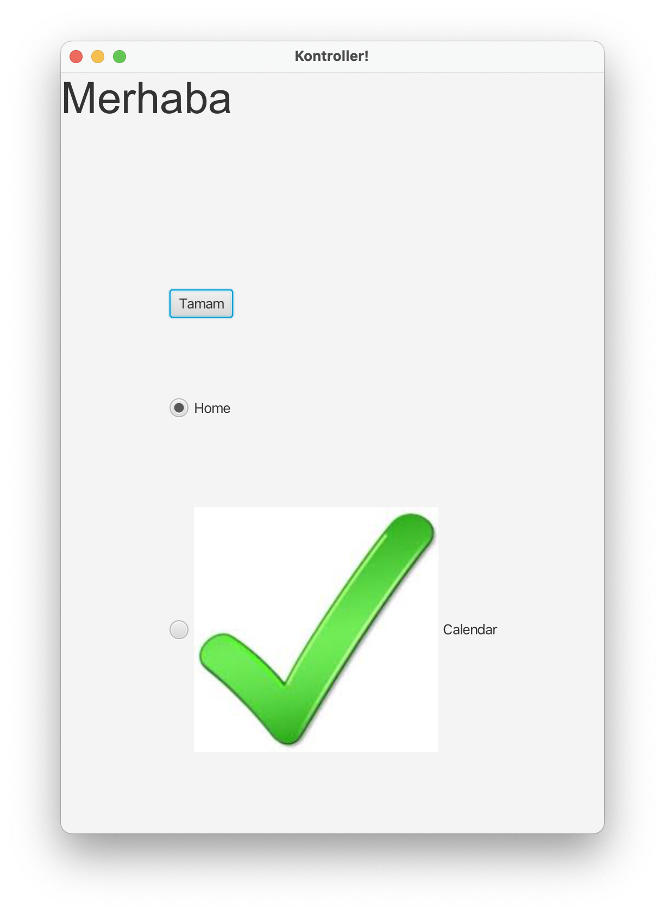
Visual Program Example - 3
Let's prepare a visual program using the radio button.

Slide 37
Radio Button Program
package com.example.kontrollerprj1;
import javafx.application.Application;
import javafx.fxml.FXMLLoader;
import javafx.scene.Parent;
import javafx.scene.Scene;
import javafx.scene.control.Button;
import javafx.scene.control.Label;
import javafx.scene.control.RadioButton;
import javafx.scene.control.ToggleGroup;
import javafx.scene.image.Image;
import javafx.scene.image.ImageView;
import javafx.scene.layout.AnchorPane;
import javafx.scene.text.Font;
import javafx.stage.Stage;
import java.io.IOException;
public class HelloApplication extends Application {
@Override
public void start(Stage stage) throws IOException {
AnchorPane root = new AnchorPane();
Scene scene = new Scene(root, 500,700);
Label etiket = new Label ("Merhaba");
etiket.setFont(Font.font("Arial",40));
root.getChildren().add(etiket);
Button dugme = new Button("Tamam");
dugme.setLayoutX(100);
dugme.setLayoutY(200);
dugme.setFont(Font.font("Calibri"));
root.getChildren().add(dugme);
//A radio button with an empty string for its label
RadioButton rb1 = new RadioButton();
//Setting a text label
rb1.setText("Home");
//A radio button with the specified label
RadioButton rb2 = new RadioButton("Calendar");
rb1.setLayoutX(100);
rb1.setLayoutY(300);
rb2.setLayoutX(100);
rb2.setLayoutY(400);
Image image = new Image(getClass().getResourceAsStream("/ok.jpg"));
rb2.setGraphic(new ImageView(image));
final ToggleGroup group = new ToggleGroup();
rb1.setToggleGroup(group);
rb1.setSelected(true);
rb2.setToggleGroup(group);
root.getChildren().add(rb1);
root.getChildren().add(rb2);
stage.setTitle("Kontroller!");
stage.setScene(scene);
/* Parent root = FXMLLoader.load(getClass().getResource("hello-view.fxml"));
Scene scene = new Scene(root, 600,600);
stage.setScene(scene);
*/
stage.show();
}
public static void main(String[] args) {
launch();
}
}

Slide 38
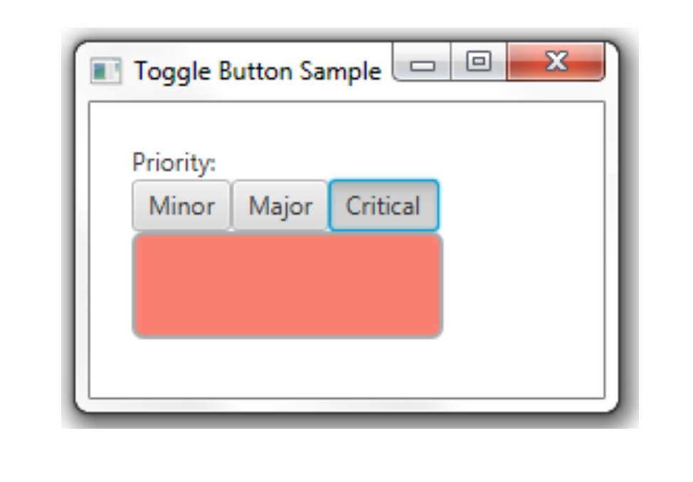
Toggle Button
Multiple buttons can be grouped, allowing only one to be selected.
//A toggle button without any caption or icon
ToggleButton tb1 = new ToggleButton();
//A toggle button with a text caption
ToggleButton tb2 = new ToggleButton("Press me");
//A toggle button with a text caption and an icon
Image image = new Image(getClass().getResourceAsStream("/ok.jpg"));
ToggleButton tb3 = new ToggleButton ("Press me", new ImageView(image));

Slide 39
Toggle Button
In the Toggle Buttons group, it is necessary to group only 1 toggle button to ensure that it is selected.

Slide 40
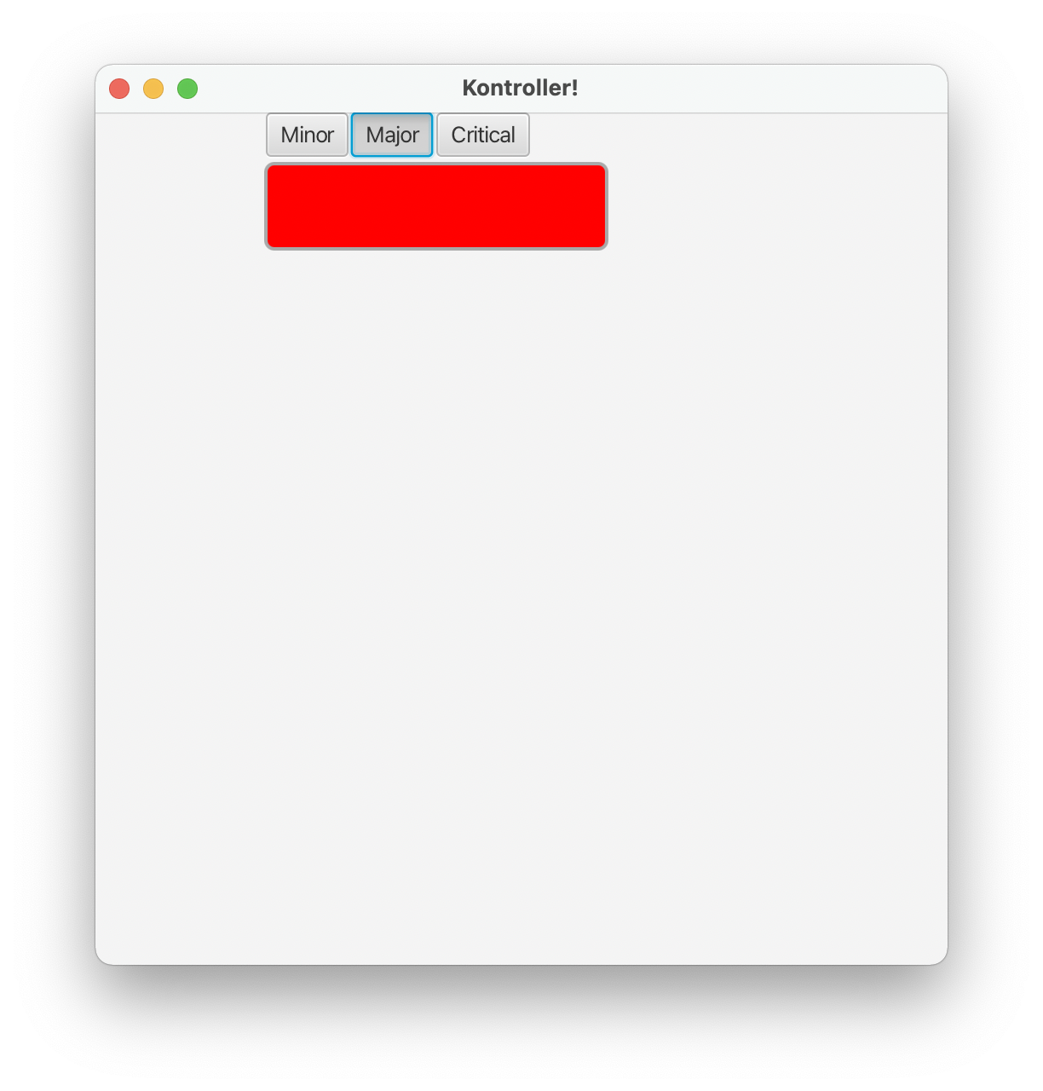
Visual Program Example - 4
Let's prepare a visual program using the Toggle button.

Slide 41
Toggle Button Program
package com.example.kontrollerprj1;
import javafx.application.Application;
import javafx.fxml.FXMLLoader;
import javafx.scene.Parent;
import javafx.scene.Scene;
import javafx.scene.control.*;
import javafx.scene.image.Image;
import javafx.scene.image.ImageView;
import javafx.scene.layout.AnchorPane;
import javafx.scene.paint.Color;
import javafx.scene.shape.Rectangle;
import javafx.scene.text.Font;
import javafx.stage.Stage;
import java.io.IOException;
public class HelloApplication extends Application {
@Override
public void start(Stage stage) throws IOException {
AnchorPane root = new AnchorPane();
Scene scene = new Scene(root, 500,500);
final ToggleGroup group = new ToggleGroup();
ToggleButton tb1 = new ToggleButton("Minor");
tb1.setToggleGroup(group);
tb1.setSelected(true);
ToggleButton tb2 = new ToggleButton("Major");
tb2.setToggleGroup(group);
ToggleButton tb3 = new ToggleButton("Critical");
tb3.setToggleGroup(group);
tb1.setLayoutX(100);
tb2.setLayoutX(150);
tb3.setLayoutX(200);
tb1.setUserData(Color.LIGHTGREEN);
tb2.setUserData(Color.LIGHTBLUE);
tb3.setUserData(Color.SALMON);
Rectangle rect = new Rectangle();
rect.setLayoutX(100);
rect.setHeight(50);
rect.setLayoutY(30);
rect.setWidth(200);
rect.setFill(Color.RED);
rect.setStroke(Color.DARKGRAY);
rect.setStrokeWidth(2);
rect.setArcHeight(10);
rect.setArcWidth(10);
root.getChildren().add(tb1);
root.getChildren().add(tb2);
root.getChildren().add(tb3);
root.getChildren().add(rect);
stage.setTitle("Kontroller!");
stage.setScene(scene);
/* Parent root = FXMLLoader.load(getClass().getResource("hello-view.fxml"));
Scene scene = new Scene(root, 600,600);
stage.setScene(scene);
*/
stage.show();
}
public static void main(String[] args) {
launch();
}
}

Slide 42
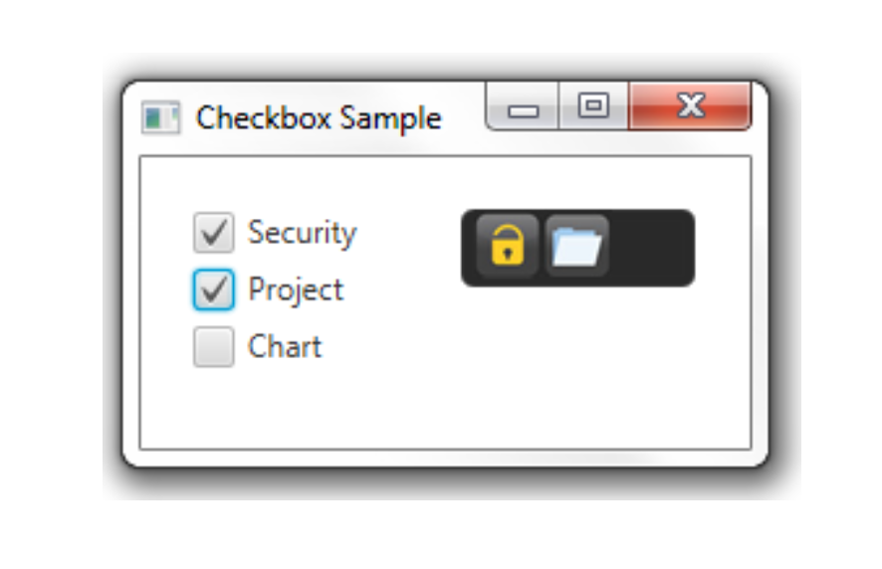
Checkbox
Although checkboxes are similar to radio buttons, it is not allowed to use grouping.

Slide 43
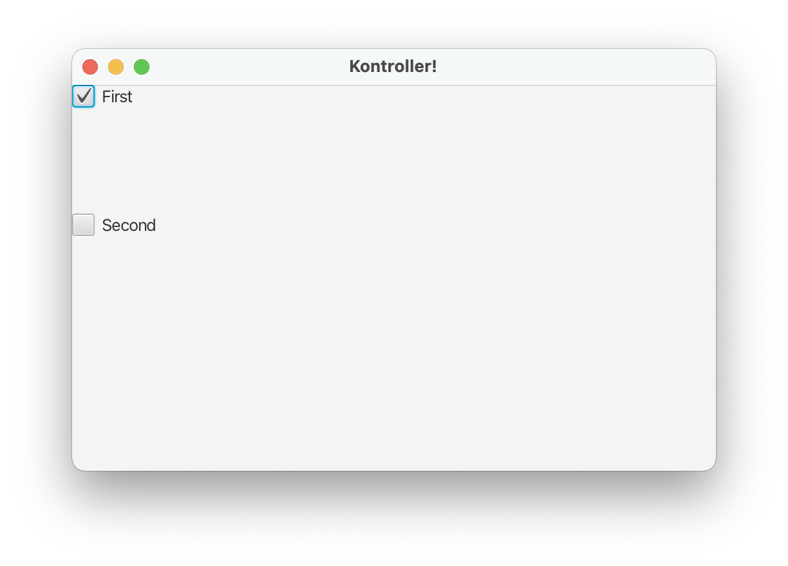
Visual Program Example - 5
Let's prepare a visual program using a checkbox.

Slide 44
Checkbox Program
package com.example.kontrollerprj1;
import javafx.application.Application;
import javafx.fxml.FXMLLoader;
import javafx.scene.Parent;
import javafx.scene.Scene;
import javafx.scene.control.*;
import javafx.scene.image.Image;
import javafx.scene.image.ImageView;
import javafx.scene.layout.AnchorPane;
import javafx.scene.paint.Color;
import javafx.scene.shape.Rectangle;
import javafx.scene.text.Font;
import javafx.stage.Stage;
import java.io.IOException;
public class HelloApplication extends Application {
@Override
public void start(Stage stage) throws IOException {
AnchorPane root = new AnchorPane();
Scene scene = new Scene(root, 500,500);
//A checkbox CheckBox cb1 without a caption
CheckBox cb1= new CheckBox();
// A checkbox CheckBox cb2 with a string caption
CheckBox cb2 = new CheckBox("Second");
cb1.setText("First");
cb1.setSelected(true);
cb2.setLayoutY(100);
root.getChildren().add(cb1);
root.getChildren().add(cb2);
stage.setTitle("Kontroller!");
stage.setScene(scene);
stage.show();
}
public static void main(String[] args) {
launch();
}
}

Slide 45
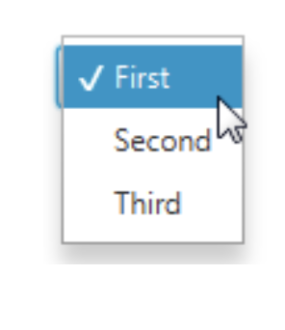
Choicebox
Choiceboxes allow you to select elements from a list.
ChoiceBox cb = new ChoiceBox(); cb.setItems(FXCollections.observableArrayList(
"New Document", "Open ",
new Separator(), "Save", "Save as") );

Slide 46
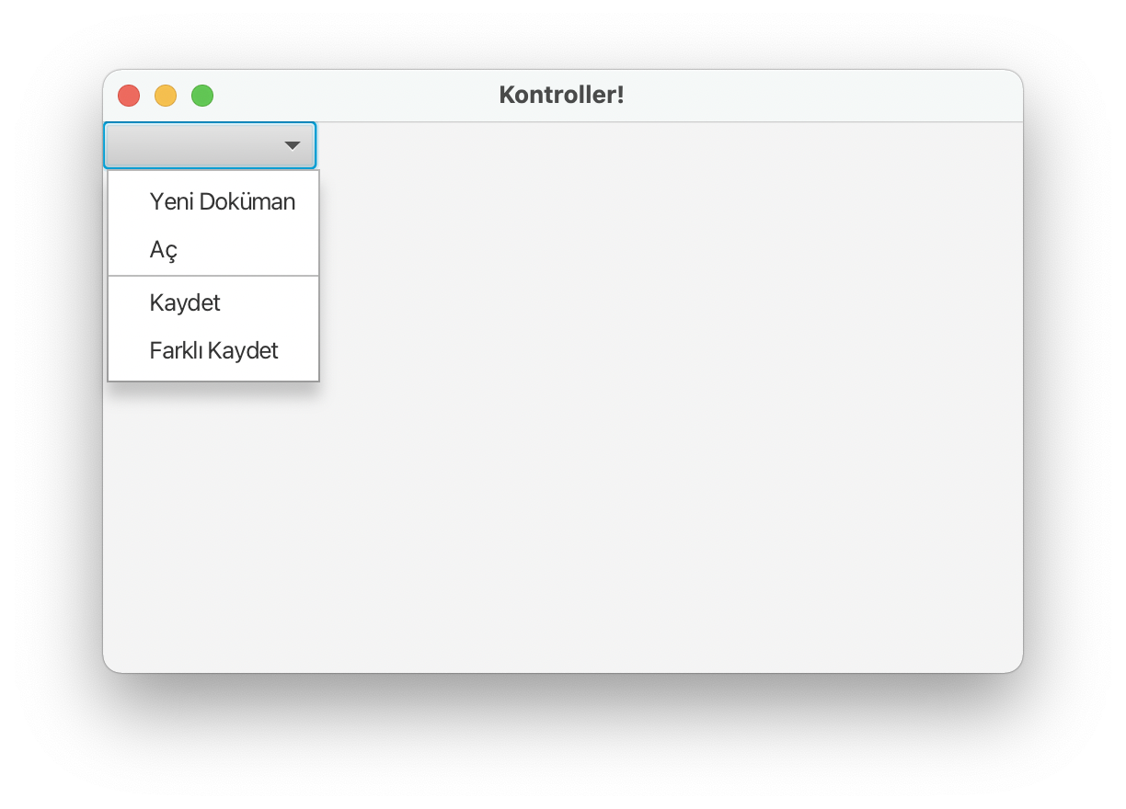
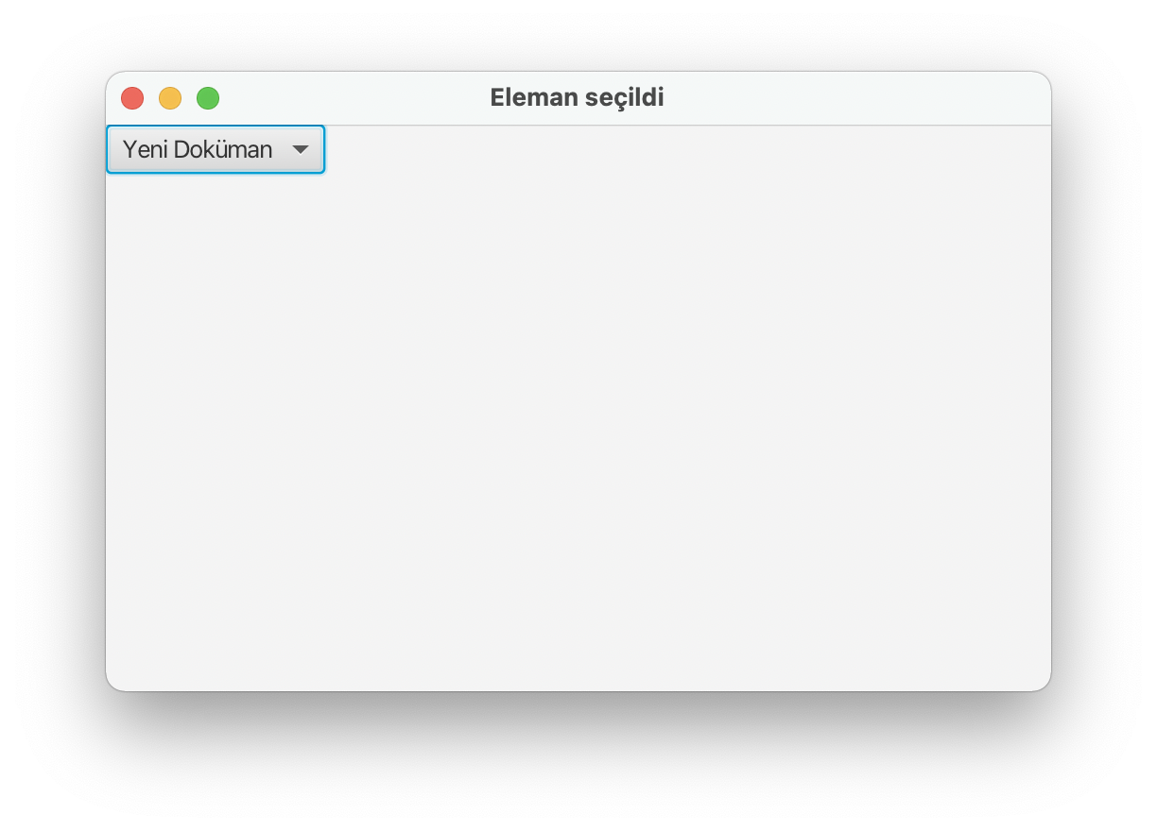
Visual Program Example - 6
Let's prepare a visual program using Choicebox.

Slide 47
Choicebox Program
package com.example.kontrollerprj1;
import javafx.application.Application;
import javafx.beans.value.ObservableValue;
import javafx.collections.FXCollections;
import javafx.fxml.FXMLLoader;
import javafx.scene.Parent;
import javafx.scene.Scene;
import javafx.scene.control.*;
import javafx.scene.image.Image;
import javafx.scene.image.ImageView;
import javafx.scene.layout.AnchorPane;
import javafx.scene.paint.Color;
import javafx.scene.shape.Rectangle;
import javafx.scene.text.Font;
import javafx.stage.Stage;
import java.io.IOException;
public class HelloApplication extends Application {
@Override
public void start(Stage stage) throws IOException {
AnchorPane root = new AnchorPane();
Scene scene = new Scene(root, 500,300);
ChoiceBox cb1=new ChoiceBox();
cb1.setItems(FXCollections.observableArrayList("Yeni Doküman", "Aç", new Separator(),"Kaydet", "Farklı Kaydet"));
cb1.getSelectionModel().selectedIndexProperty().addListener(
(ObservableValue<? extends Number> ov, Number old_val, Number new_val) -> { stage.setTitle("Eleman seçildi");});
root.getChildren().add(cb1);
stage.setTitle("Kontroller!");
stage.setScene(scene);
stage.show();
}
public static void main(String[] args) {
launch();
}
}

Slide 48
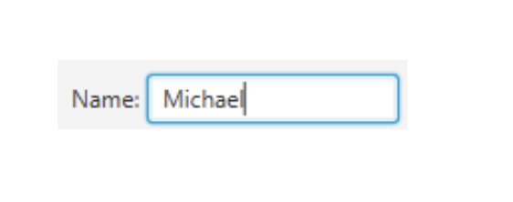
Textfield
You can read the input with the textfield.
Label label1 = new Label("Adınız:");
TextField textField = new TextField ();
HBox hb = new HBox();
hb.getChildren().addAll(label1, textField);
hb.setSpacing(10);
root.getChildren().add(hb);

Slide 49
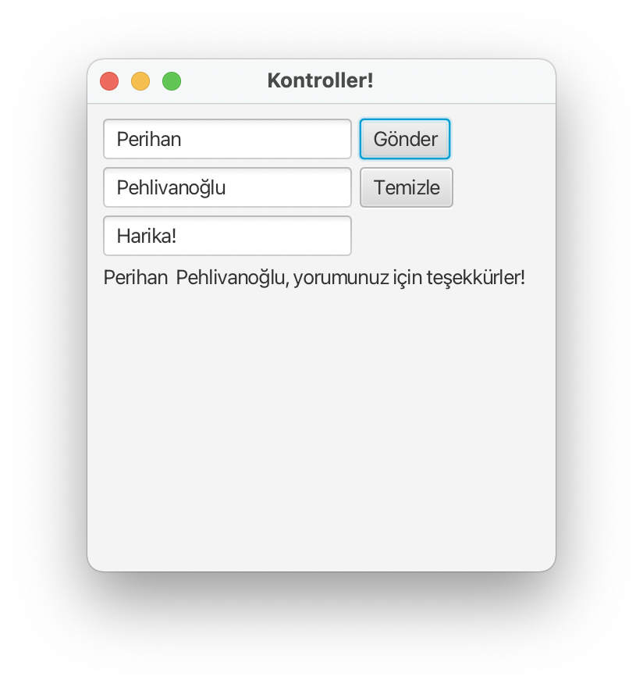
Visual Program Örnek - 7
Let's prepare a visual program using a textfield.

Slide 50
Textfield Program
package com.example.kontrollerprj1;
import javafx.application.Application;
import javafx.event.ActionEvent;
import javafx.geometry.Insets;
import javafx.scene.Scene;
import javafx.scene.control.*;
import javafx.scene.layout.GridPane;
import javafx.scene.layout.HBox;
import javafx.scene.paint.Color;
import javafx.scene.text.Font;
import javafx.stage.Stage;
import java.io.IOException;
public class HelloApplication extends Application {
@Override
public void start(Stage stage) throws IOException {
GridPane root = new GridPane();
root.setPadding(new Insets(10, 10, 10, 10));
root.setVgap(5);
root.setHgap(5);
//Defining the Name text field
final TextField ad = new TextField();
ad.setPromptText("Adınızı giriniz.");
GridPane.setConstraints(ad, 0, 0);
root.getChildren().add(ad);
//Defining the Last Name text field
final TextField soyad = new TextField();
soyad.setPromptText("Soyadınızı giriniz.");
GridPane.setConstraints(soyad, 0, 1);
root.getChildren().add(soyad);
//Defining the Comment text field
final TextField yorum = new TextField();
yorum.setPromptText("Yorumunuz.");
GridPane.setConstraints(yorum, 0, 2);
root.getChildren().add(yorum);
//Defining the Submit button
Button gonder = new Button("Gönder");
GridPane.setConstraints(gonder, 1, 0);
root.getChildren().add(gonder);
//Defining the Clear button
Button temizle = new Button("Temizle");
GridPane.setConstraints(temizle, 1, 1);
root.getChildren().add(temizle);
stage.setTitle("Kontroller!");
Scene scene = new Scene(root,300,300);
stage.setScene(scene);
//Adding a Label
final Label label = new Label(); GridPane.setConstraints(label, 0, 3);
GridPane.setColumnSpan(label, 2);
root.getChildren().add(label);
gonder.setOnAction((ActionEvent e) -> { if(
(yorum.getText() != null && !yorum.getText().isEmpty()) ){
label.setText(ad.getText() + " " + soyad.getText() + ", "
+ "yorumunuz için teşekkürler!");
}else{
label.setText("Bir yorum yapmadınız.");
} });
temizle.setOnAction((ActionEvent e) -> { ad.clear();
soyad.clear(); yorum.clear(); label.setText(null);
});
stage.show();
}
public static void main(String[] args) {
launch();
}
}

Slide 51
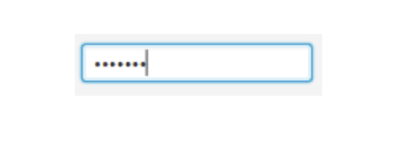
Password Field
You can read the password with the password field.
PasswordField passwordField = new PasswordField();
passwordField.setPromptText("Şifreniz");

Slide 52
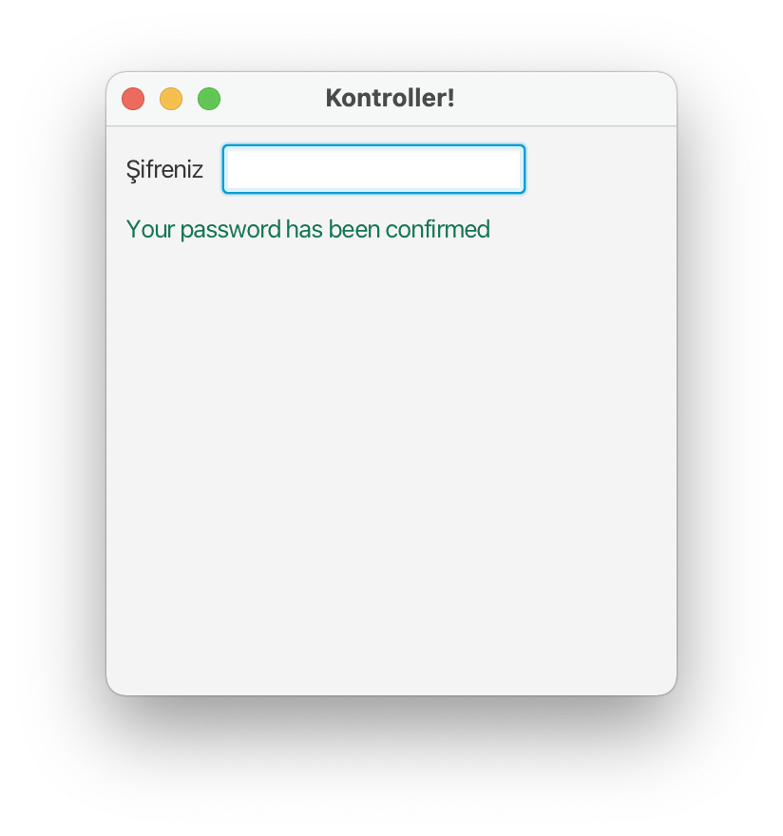
Visual Program Example - 8
Let's prepare a visual program using Password.

Slide 53
Password Program
package com.example.kontrollerprj1;
import javafx.application.Application;
import javafx.event.ActionEvent;
import javafx.geometry.Insets;
import javafx.geometry.Pos;
import javafx.scene.Scene;
import javafx.scene.control.*;
import javafx.scene.layout.GridPane;
import javafx.scene.layout.HBox;
import javafx.scene.layout.VBox;
import javafx.scene.paint.Color;
import javafx.scene.text.Font;
import javafx.stage.Stage;
import java.io.IOException;
public class HelloApplication extends Application {
@Override
public void start(Stage stage) throws IOException {
final Label message = new Label("");
VBox vb = new VBox();
vb.setPadding(new Insets(10, 0, 0, 10));
vb.setSpacing(10);
HBox hb = new HBox();
hb.setSpacing(10);
hb.setAlignment(Pos.CENTER_LEFT);
stage.setTitle("Kontroller!");
Scene scene = new Scene(vb,300,300);
Label label = new Label("Şifreniz");
PasswordField pb = new PasswordField();
pb.setOnAction((ActionEvent e) -> {
if (!pb.getText().equals("AA")) {
message.setText("Your password is incorrect!");
message.setTextFill(Color.rgb(210, 39, 30)); }else{
message.setText("Your password has been confirmed");
message.setTextFill(Color.rgb(21, 117, 84)); }
pb.clear(); });
vb.getChildren().addAll(hb, message);
hb.getChildren().addAll(label, pb);
stage.setScene(scene);
stage.show();
}
public static void main(String[] args) {
launch();
}
}

Slide 54
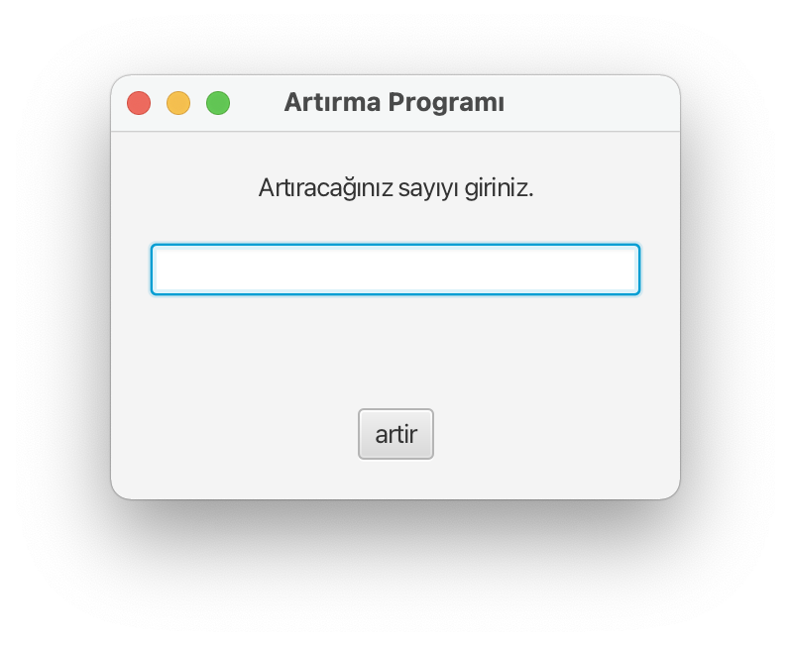
Visual Program Example - 9
Write the program according to the screenshot below.
Tamsayıyı Stringe dönüştürme:
giris.setText(String.valueOf(Integer.valueOf(yeniDeger)));
Stringi Tamsayıya dönüştürme:
yeniDeger=Integer.parseInt(giris.getText());

Slide 55
Visual Program Example - 9
package com.example.yeni2;
import javafx.application.Application;
import javafx.fxml.FXMLLoader;
import javafx.scene.Scene;
import javafx.stage.Stage;
import java.io.IOException;
public class HelloApplication extends Application{
public static void main(String[] args) {
launch();
}
@Override
public void start(Stage stage) throws Exception {
FXMLLoader yukle = new FXMLLoader(getClass().getResource("hello-view.fxml"));
Scene ekran = new Scene(yukle.load());
stage.setScene(ekran);
stage.setTitle(“Artırma Programı");
stage.show();
}
}

Slide 56
Visual Program Example - 9
package com.example.yeni2;
import javafx.event.ActionEvent;
import javafx.fxml.FXML;
import javafx.scene.control.Button;
import javafx.scene.control.Label;
import javafx.scene.control.TextField;
import java.util.Random;
public class HelloController {
@FXML
private Label label;
@FXML
private Button artir;
@FXML
private TextField giris;
public void tikla(ActionEvent e)
{
int yeniDeger=1;
if (giris.getText().isEmpty())
giris.setText(String.valueOf(Integer.valueOf(yeniDeger)));
yeniDeger=Integer.parseInt(giris.getText());
yeniDeger=yeniDeger+1;
giris.setText(String.valueOf(yeniDeger));
}
}

Slide 57
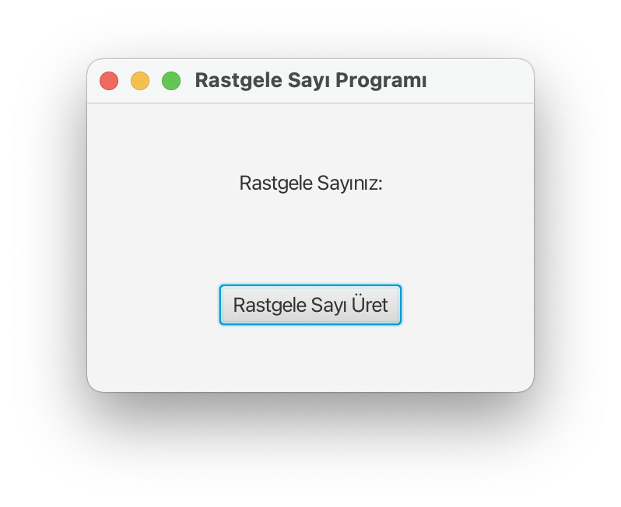
Visual Program Example - 10
Write the program according to the screenshot below.
Tamsayıyı Stringe dönüştürme:
giris.setText(String.valueOf(Integer.valueOf(yeniDeger)));
Stringi Tamsayıya dönüştürme:
yeniDeger=Integer.parseInt(giris.getText());

Slide 58
Visual Program Example - 10
package com.example.yeni2;
import javafx.application.Application;
import javafx.fxml.FXMLLoader;
import javafx.scene.Scene;
import javafx.stage.Stage;
import java.io.IOException;
public class HelloApplication extends Application{
public static void main(String[] args) {
launch();
}
@Override
public void start(Stage stage) throws Exception {
FXMLLoader yukle = new FXMLLoader(getClass().getResource("hello-view.fxml"));
Scene ekran = new Scene(yukle.load());
stage.setScene(ekran);
stage.setTitle("Rastgele Sayı Programı");
stage.show();
}
}

Slide 59
Visual Program Example - 10
package com.example.yeni2;
import javafx.event.ActionEvent;
import javafx.fxml.FXML;
import javafx.scene.control.Button;
import javafx.scene.control.Label;
import javafx.scene.control.TextField;
import java.util.Random;
public class HelloController {
@FXML
private Label label;
@FXML
private Button artir;
public void tikla(ActionEvent e)
{
Random rastgele =new Random();
label.setText(String.valueOf(rastgele.nextInt(100)));
}
}

Slide 60
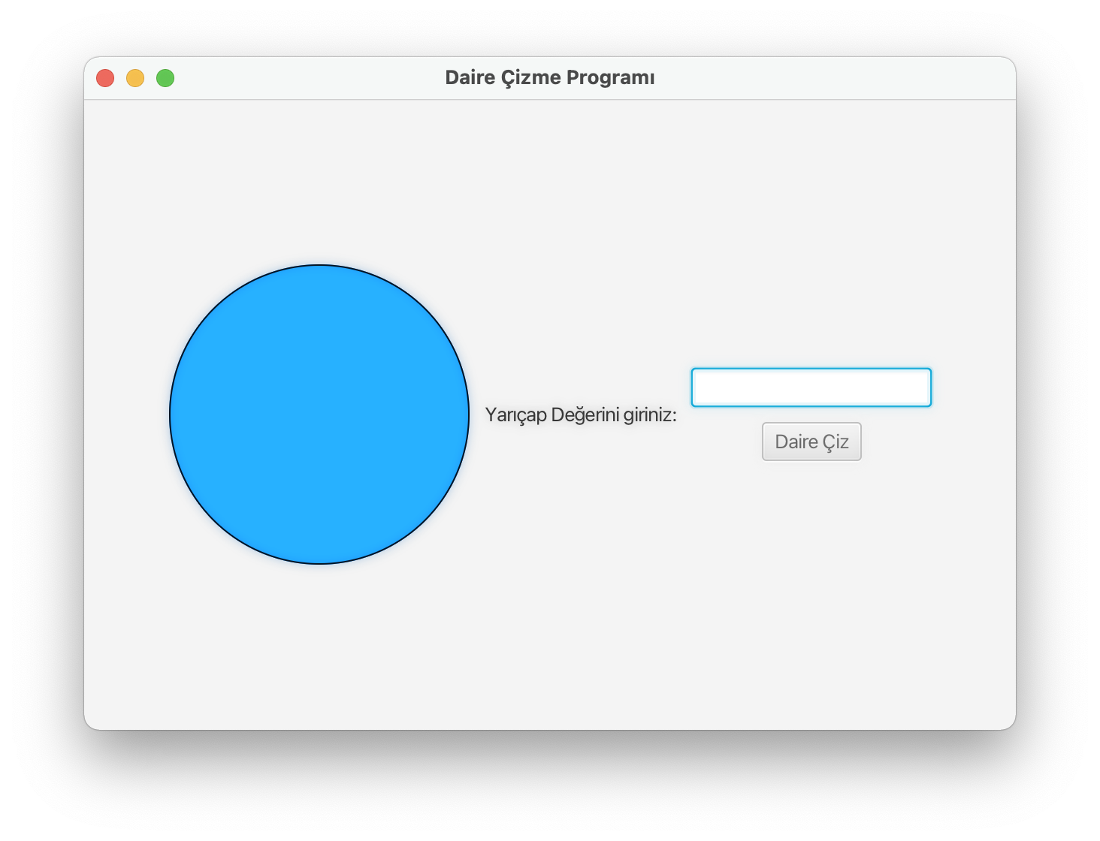
Visual Program Example - 11
Write the program according to the screenshot below.

Slide 61
Visual Program Example - 11
package com.example.yeni2;
import javafx.application.Application;
import javafx.fxml.FXMLLoader;
import javafx.scene.Scene;
import javafx.stage.Stage;
import java.io.IOException;
public class HelloApplication extends Application{
public static void main(String[] args) {
launch();
}
@Override
public void start(Stage stage) throws Exception {
FXMLLoader yukle = new FXMLLoader(getClass().getResource("hello-view.fxml"));
Scene ekran = new Scene(yukle.load());
stage.setScene(ekran);
stage.setTitle("Daire Çizme Programı");
stage.show();
}
}

Slide 62
Visual Program Example - 11
package com.example.yeni2;
import javafx.event.ActionEvent;
import javafx.fxml.FXML;
import javafx.scene.control.Button;
import javafx.scene.control.TextField;
import javafx.scene.shape.Circle;
import java.util.Random;
public class HelloController {
@FXML
private TextField yaricap;
@FXML
private Button ciz;
@FXML
private Circle c;
public void tikla(ActionEvent e)
{
if (yaricap.getText().isEmpty())
c.setRadius(5.0);
double cap;
cap=Double.parseDouble(yaricap.getText());
c.setRadius(cap);
}
}

Slide 63
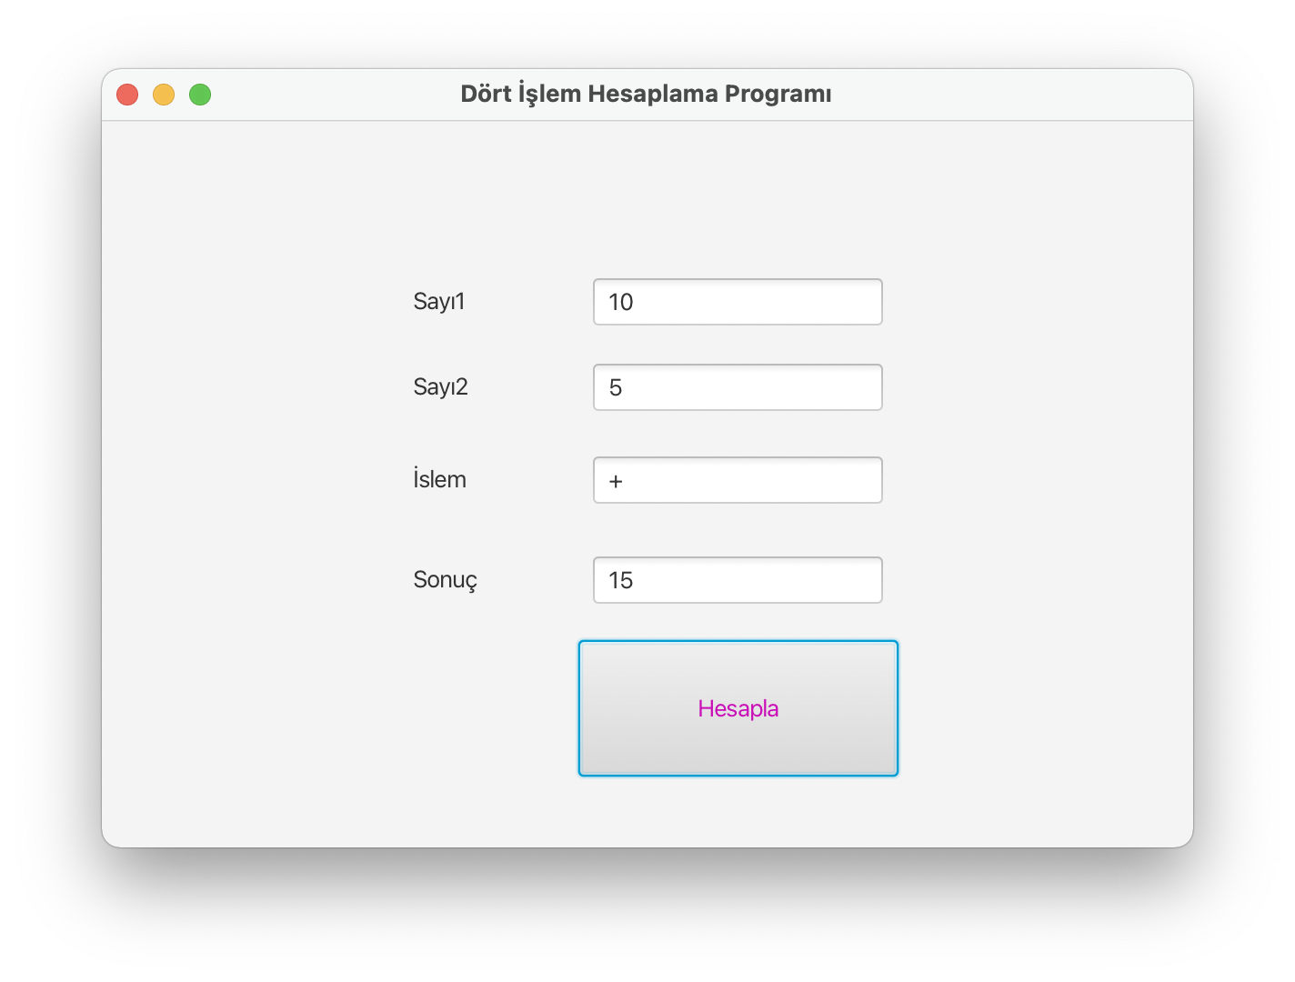
Visual Program Example - 12
Write the program according to the screenshot below.

Slide 64
Visual Program Example - 12
package com.example.yeni2;
import javafx.application.Application;
import javafx.fxml.FXMLLoader;
import javafx.scene.Scene;
import javafx.scene.image.Image;
import javafx.scene.paint.Color;
import javafx.stage.Stage;
import java.io.IOException;
public class HelloApplication extends Application{
public static void main(String[] args) {
launch();
}
@Override
public void start(Stage stage) throws Exception {
FXMLLoader yukle = new FXMLLoader(getClass().getResource("hello-view.fxml"));
Scene ekran = new Scene(yukle.load());
stage.setScene(ekran);
stage.setTitle("Dört İşlem Hesaplama Programı");
stage.show();
}
}

Slide 65
Visual Program Example - 12
package com.example.yeni2;
import javafx.event.ActionEvent;
import javafx.fxml.FXML;
import javafx.scene.control.Button;
import javafx.scene.control.TextField;
import javafx.scene.shape.Circle;
import java.util.Random;
public class HelloController {
@FXML
TextField sayi1, sayi2, islem, sonuc;
@FXML
Button hesapla;
public void tikla(ActionEvent e)
{
int result = 0;
int s1= Integer.parseInt(sayi1.getText());
int s2= Integer.parseInt(sayi2.getText());
String is = islem.getText();
if (is.isEmpty())
result=0;
if (is.equals("+"))
result=s1+s2;
else if (is.equals("-"))
result=s1-s2;
else if (is.equals("*"))
result=s1*s2;
else if (is.equals("/"))
result=s1/s2;
sonuc.setText(String.valueOf(Integer.valueOf(result)));
}
}

Slide 66
Example Example - 13
Let's implement the shape with Scene Builder.

Slide 67
Shapes Example - 13
public class HelloApplication extends Application {
@Override
public void start(Stage stage) throws IOException {
FXMLLoader fxmlLoader = new FXMLLoader(HelloApplication.class.getResource("ekran.fxml"));
Scene scene = new Scene(fxmlLoader.load(), Color.LIGHTSKYBLUE);
stage.setTitle("Hello!");
stage.setScene(scene);
stage.show();
}
public static void main(String[] args) {
launch();
}
}

Slide 68
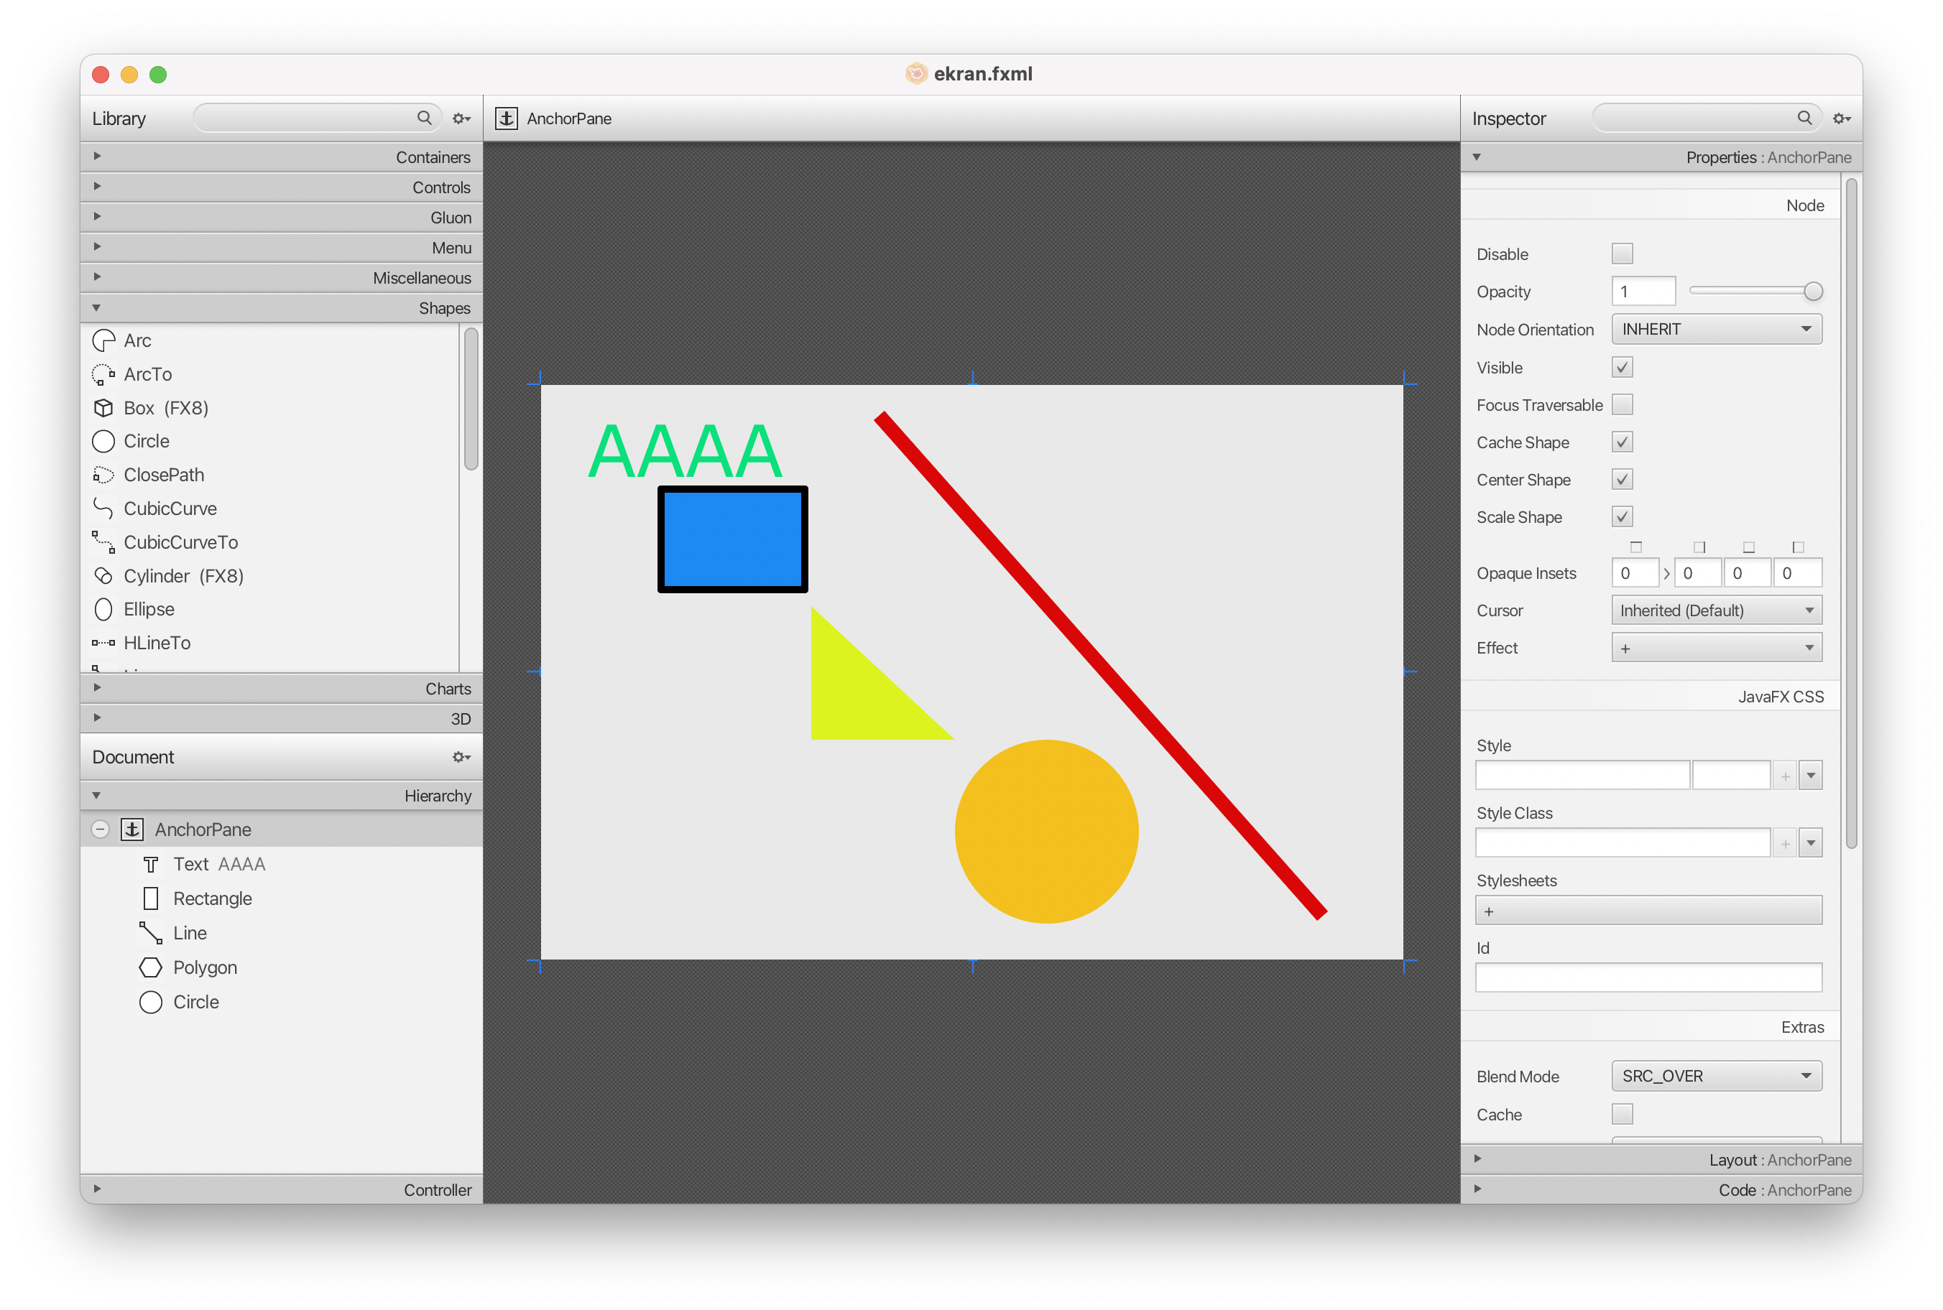
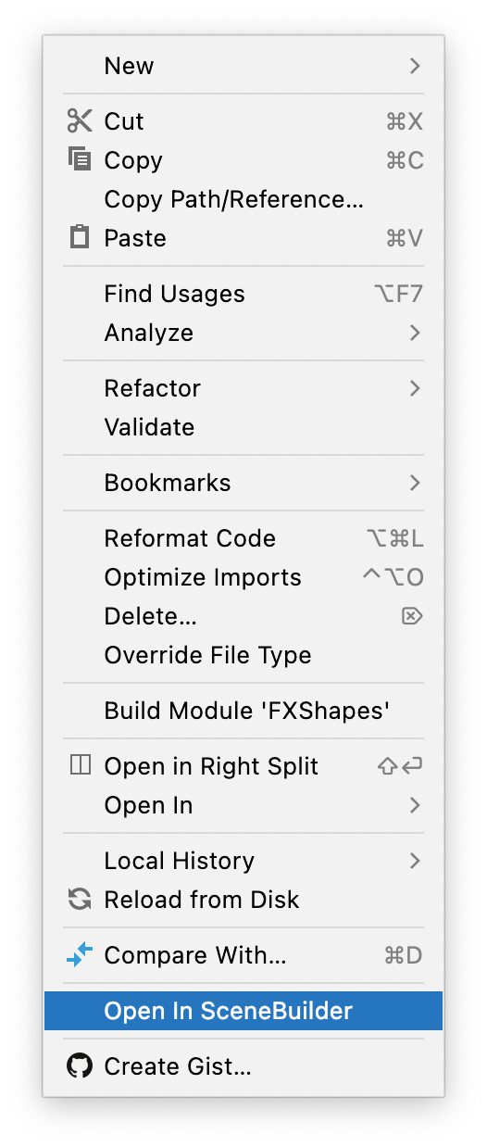
Shapes Example - 13

Slide 69
Example Example - 14
Let's develop an application that moves a shape up, down, right, left.
We will connect with the OnAction events of the buttons. We will call the .fxml file we created with the following code. Parent root = FXMLLoader.load(getClass().getResource("Main.fxml"));

Slide 70
Shapes Example - 14
package com.example.deneme4;
import javafx.application.Application;
import javafx.fxml.FXMLLoader;
import javafx.scene.Parent;
import javafx.scene.Scene;
import javafx.stage.Stage;
import java.io.IOException;
public class HelloApplication extends Application {
@Override
public void start(Stage stage) throws Exception {
try {
Parent root = FXMLLoader.load(getClass().getResource("Main.fxml"));
Scene scene = new Scene(root);
stage.setTitle("MERHABA ARKADAŞLAR!");
stage.setScene(scene);
stage.show();
} catch (Exception e){
e.printStackTrace();}
}
public static void main(String[] args) {
launch();
}
}

Slide 71
Shapes Example - 14
package com.example.deneme4;
import javafx.event.ActionEvent;
import javafx.fxml.FXML;
import javafx.scene.shape.Circle;
public class Controller {
@FXML
private Circle daire;
private double x;
private double y;
public void yukariya(ActionEvent e){
daire.setCenterY(y=y-10);
//System.out.println("Yukarıya");
}
public void asagiya(ActionEvent e){
daire.setCenterY(y=y+10);
//System.out.println("Aşağıya");
}
public void sola(ActionEvent e){
daire.setCenterX(x=x-10);
//System.out.println("Sola");
}
public void saga(ActionEvent e){
daire.setCenterX((x=x+10));
//System.out.println("Sağa");
}

Slide 72

Homework - 1
Work on adding events to your own sample program.

Slide 73
Next Lecture
We will continue to the topic.

Slide 74
Programming Session
Java FX

Slide 75
Summary
As a result, we learned the Java FX UI controls with example programs.
We will continue to the example applications next week. Come to class prepared.

